Slide 1
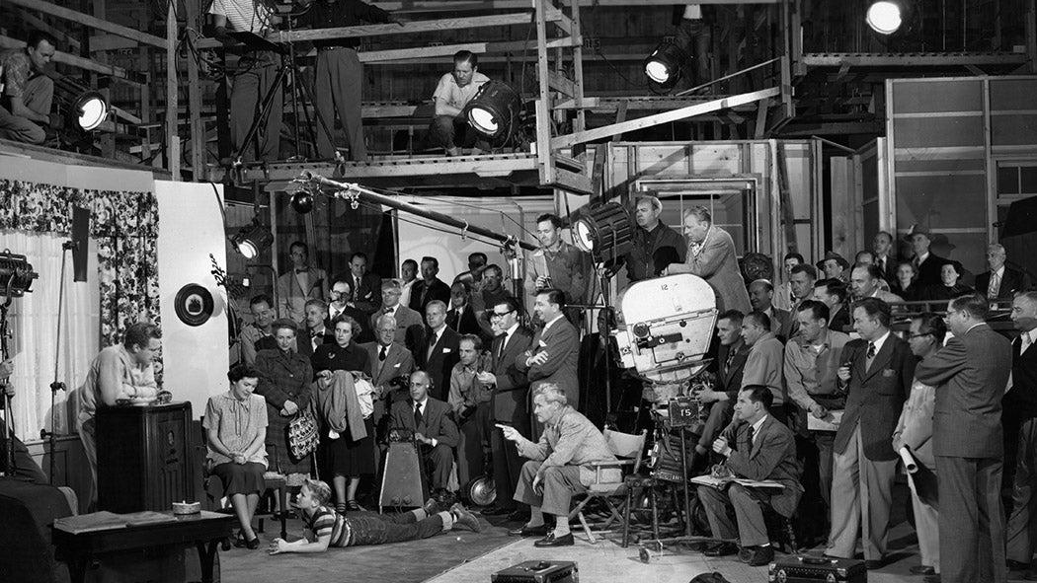
Six TV Families from the Network Era: Visual & Aural Style
Taylor Arnold
17 March 2023

Slide 2

1. Introduction
01 – Six TV Families | Introduction

Slide 3
Introduction
I apply and develop corpus-based techniques and software in order to study how messages are communicated through visual and multimodal forms.
I am particularly interested in understanding the production and reception of messages transmitted through time-based media such as television and film.
01 – Six TV Families | Introduction

Slide 4

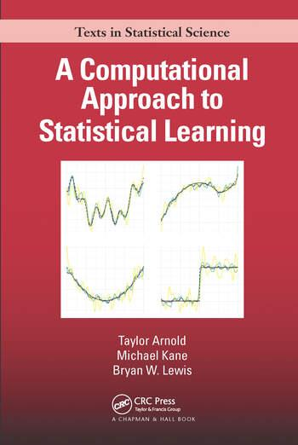

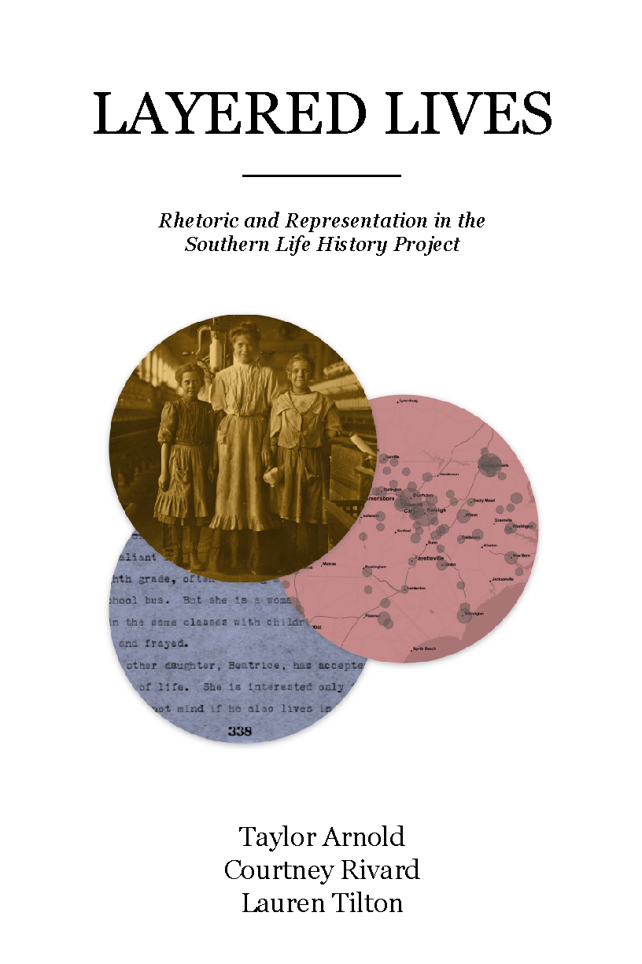
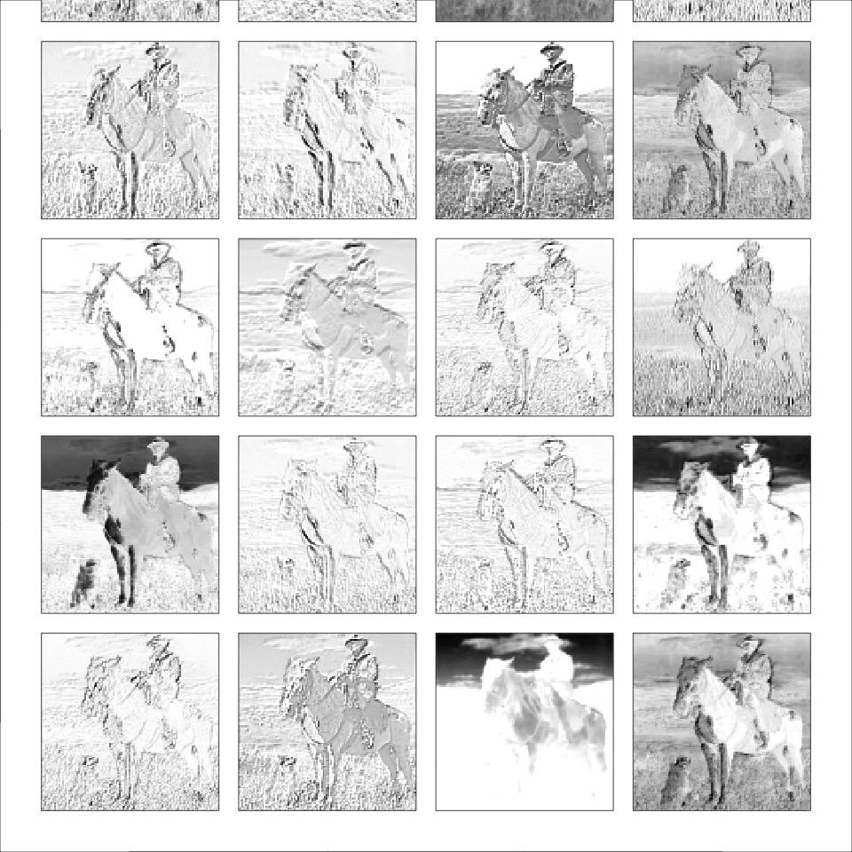
Introduction
I apply and develop corpus-based techniques and software in order to study how messages are communicated through visual and multimodal forms.
I am particularly interested in understanding the production and reception of messages transmitted through time-based media such as television and film.
DISTANT VIEWING
Analyzing Visual Culture at Scale
Taylor Arnold
Lauren Tilton
2015
2019
2022
2023
01 – Six TV Families | Introduction

Slide 5
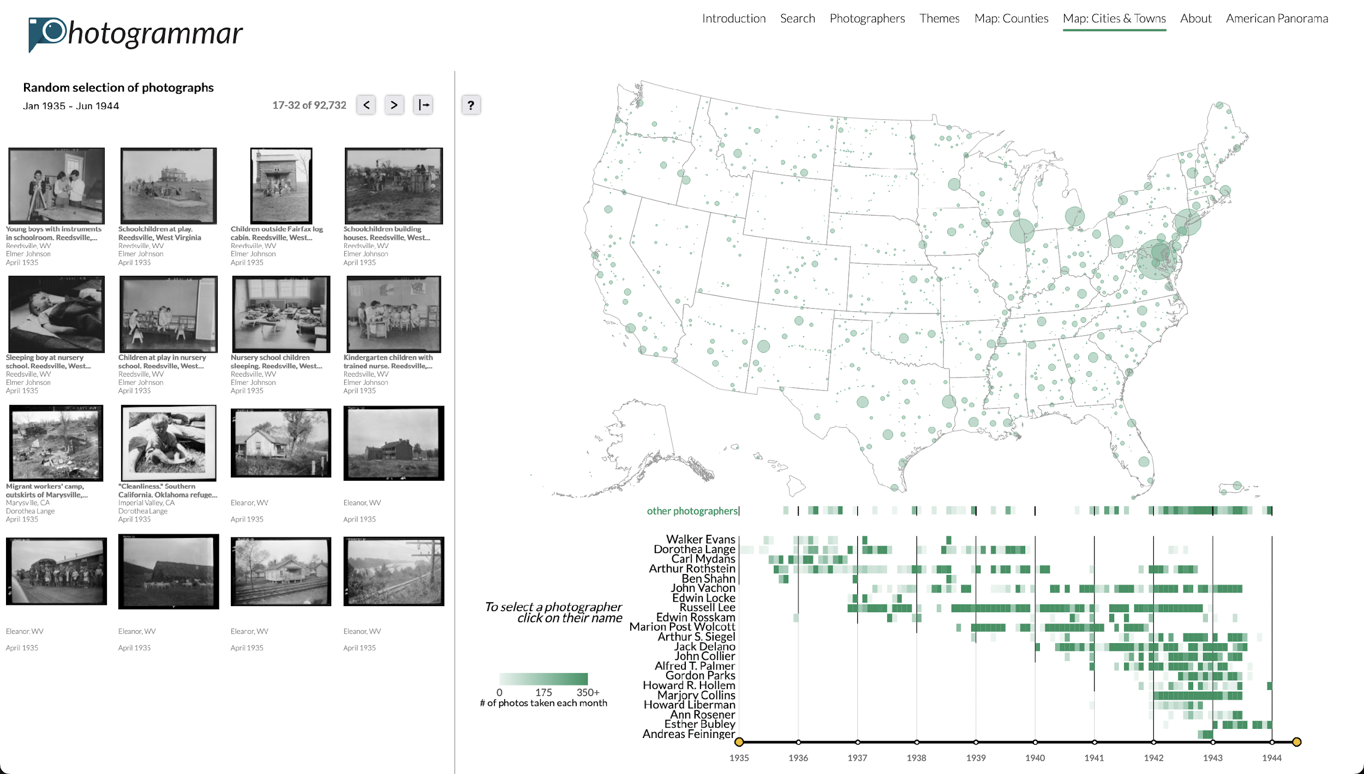
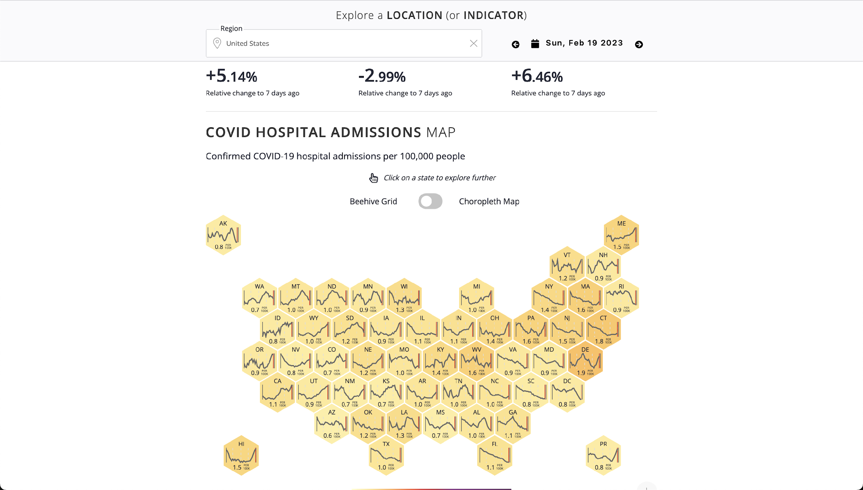
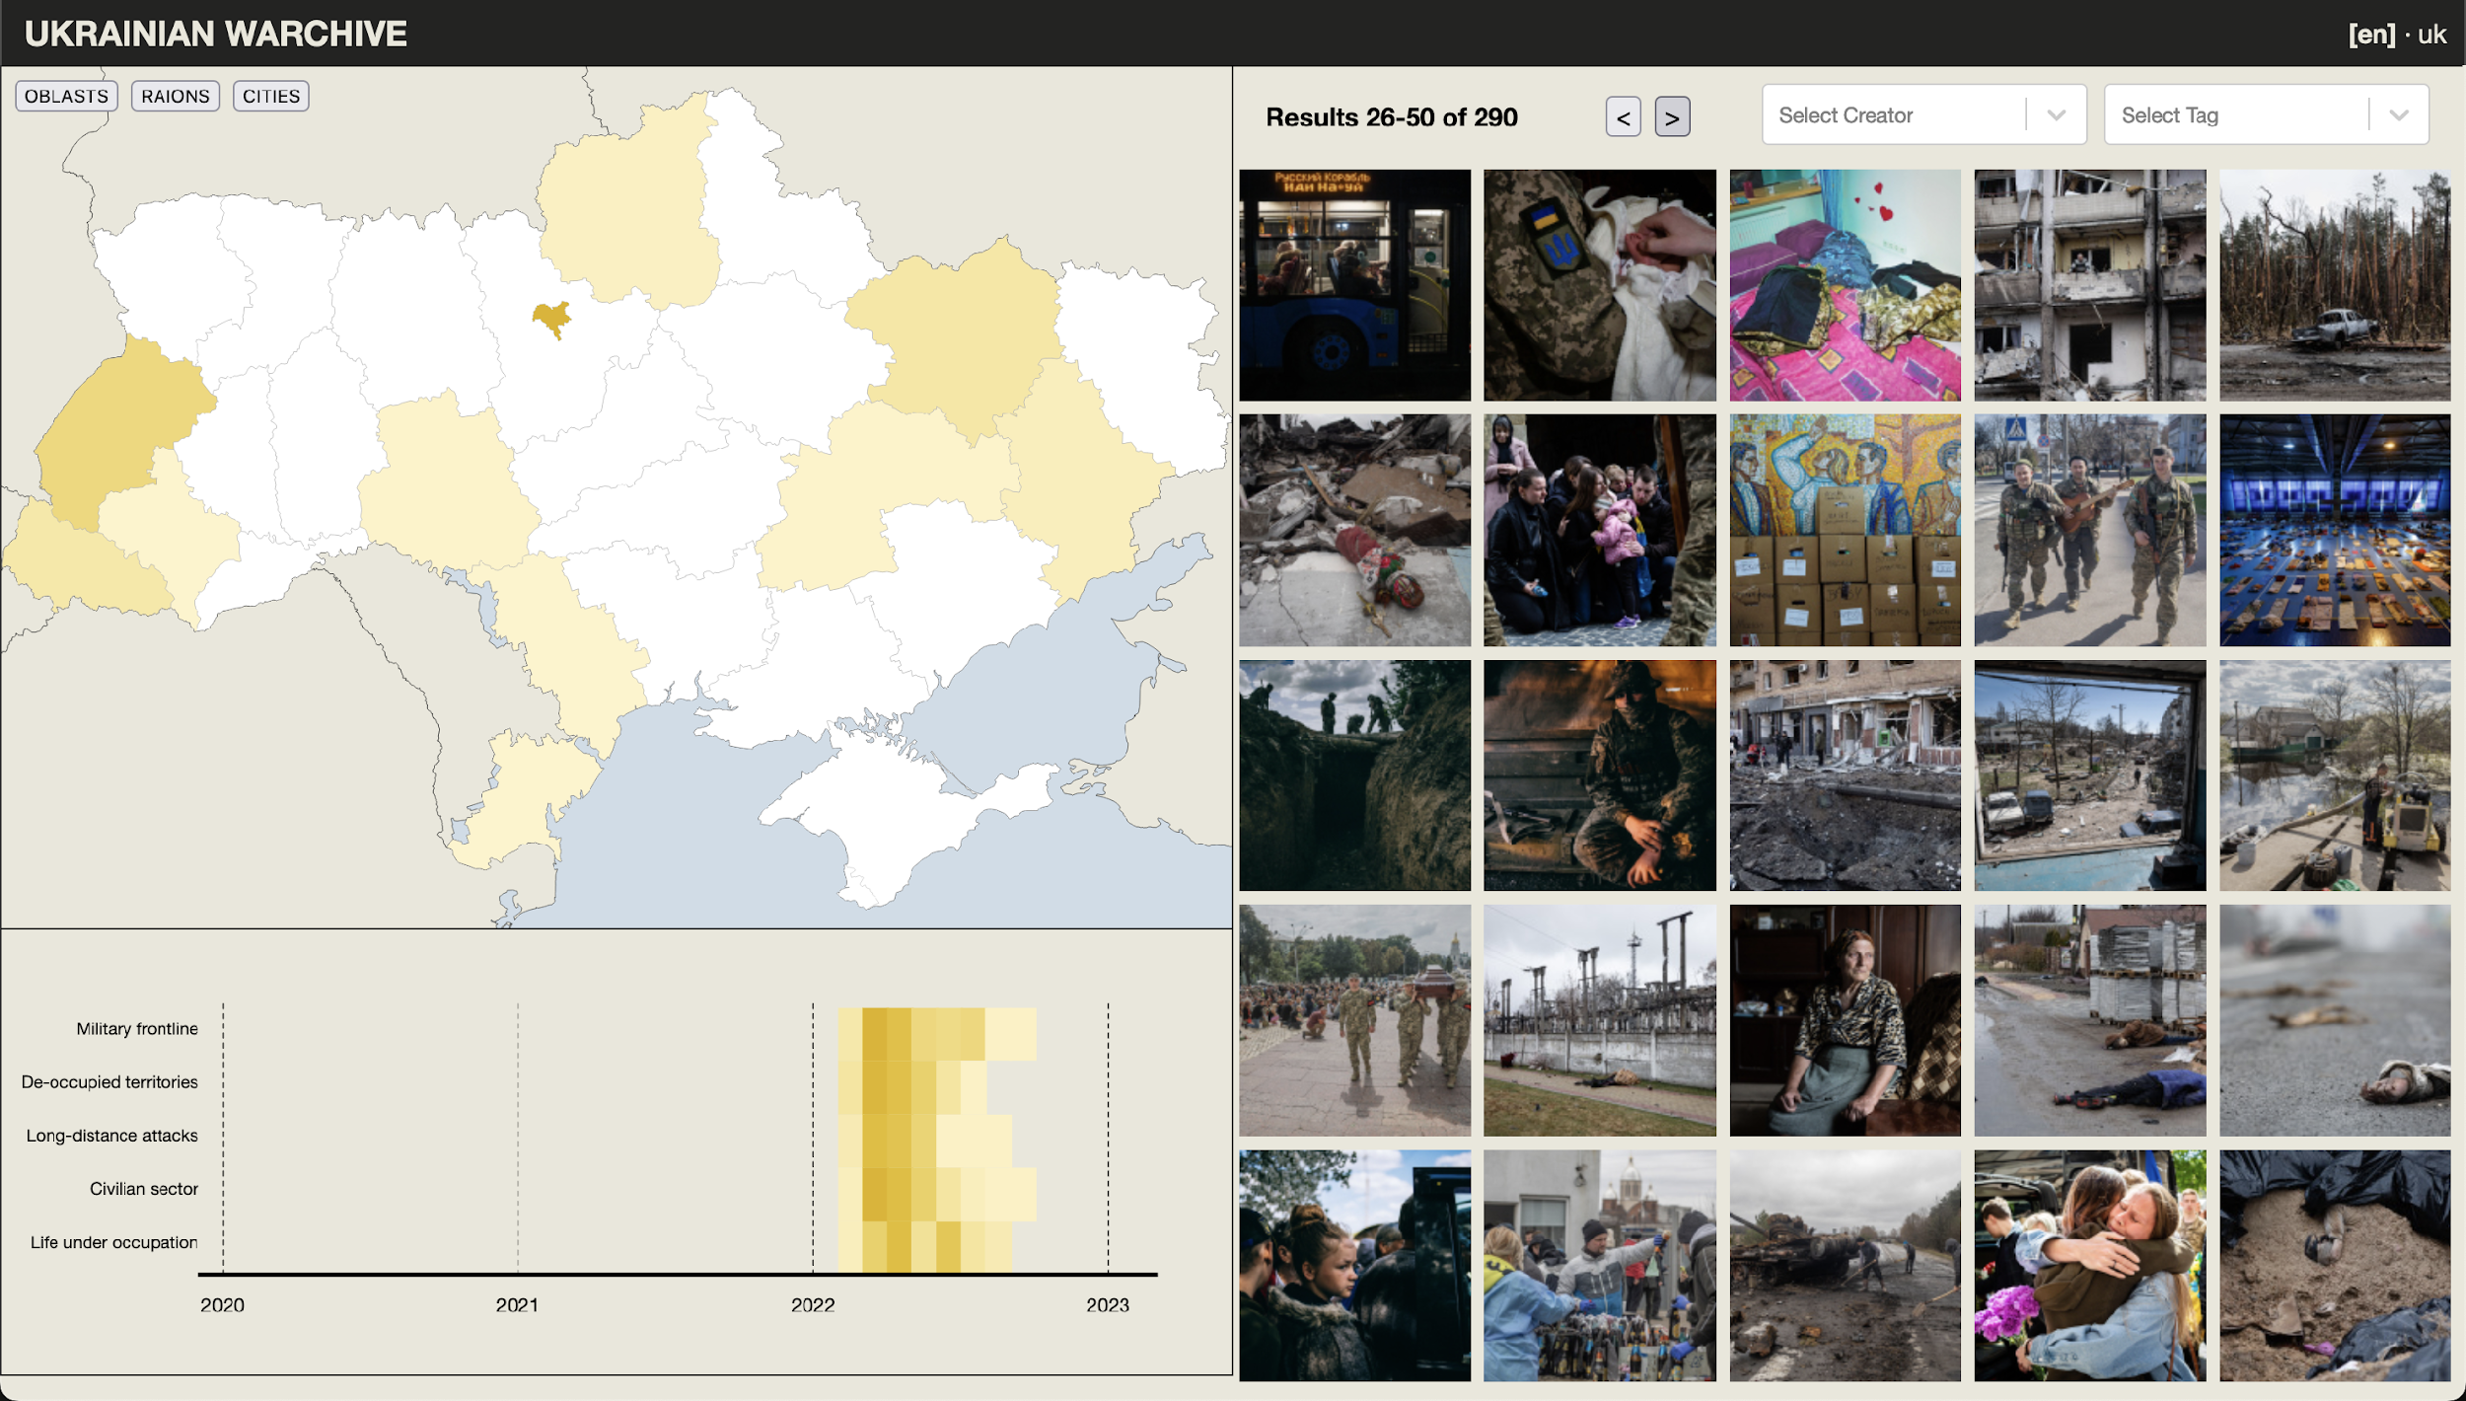
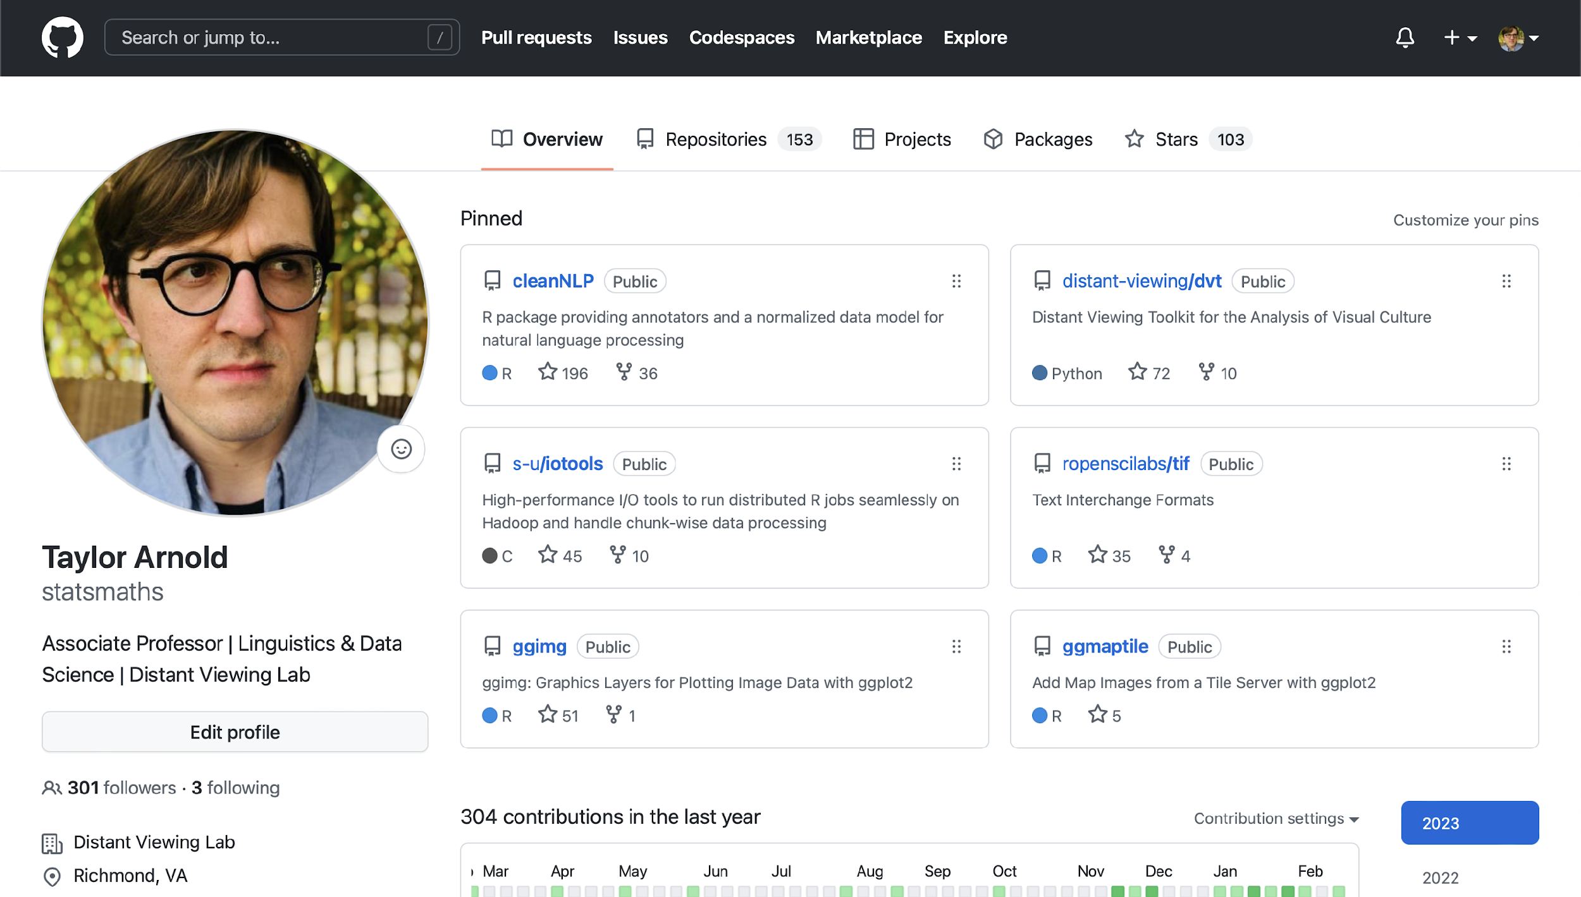
Introduction
I apply and develop corpus-based techniques and software in order to study how messages are communicated through visual and multimodal forms.
I am particularly interested in understanding the production and reception of messages transmitted through time-based media such as television and film.
DISTANT VIEWING
Analyzing Visual Culture at Scale
Taylor Arnold
Lauren Tilton
2015
2019
2022
2023
Photogrammar
COVIDcast
Ukraine, WARCHIVE
Statistical Software
01 – Six TV Families | Introduction

Slide 6





Introduction
I apply and develop corpus-based techniques and software in order to study how messages are communicated through visual and multimodal forms.
I am particularly interested in understanding the production and reception of messages transmitted through time-based media such as television and film.
DISTANT VIEWING
Analyzing Visual Culture at Scale
Taylor Arnold
Lauren Tilton
2015
2019
2022
2023
Photogrammar
COVIDcast
Ukraine, WARCHIVE
Statistical Software
01 – Six TV Families | Introduction

Slide 7
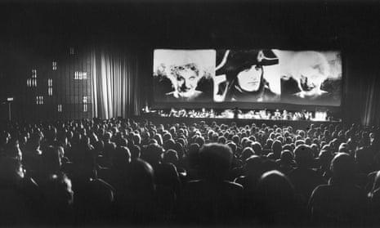
Film Studies: Close and Computational Analyses
Influenced by literary studies and art history, there has been a long tradition within film studies to engage in a close analysis of the form, style, and content of feature-length films.
Screening of Napoleon (1927)
01 – Six TV Families | Introduction

Slide 8
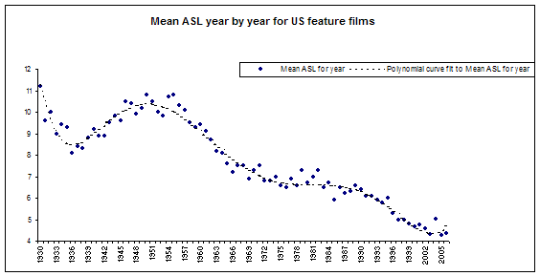
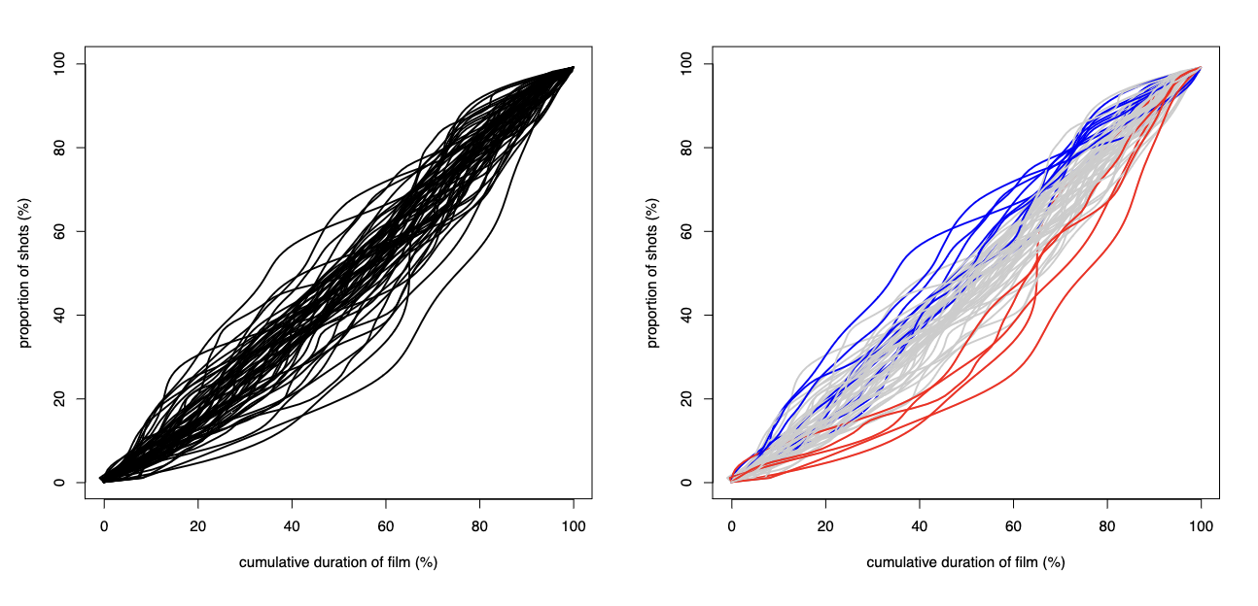
Film Studies: Close and Computational Analyses
Influenced by literary studies and art history, there has been a long tradition within film studies to engage in a close analysis of the form, style, and content of feature-length films.
Some researchers have begun to integrate quantitative measurements into their analyses of film, including David Bordwell, Jeremy Butler, Gunars Civjans, Barbara Flueckiger, Daria Khitrova, Barry Salt, and Yuri Tsivian.
The bulk of this work has focused on the analysis of the duration of shots within a film.
Sample analyses from the Cinemetrics project.
01 – Six TV Families | Introduction

Slide 9
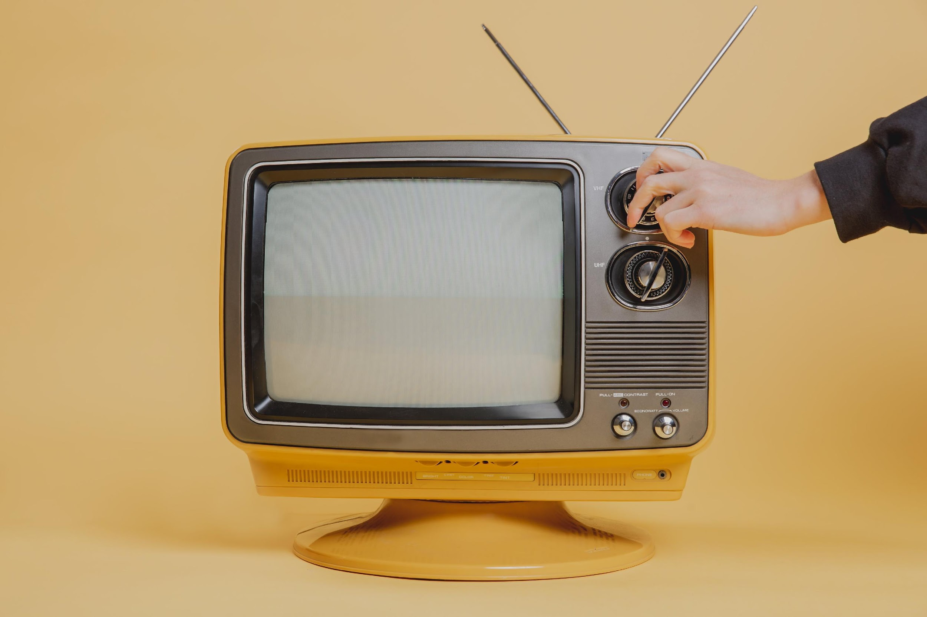
Quantitative Analysis of Television
Today, showing an expansion of the existing techniques in quantitative film analysis along three dimensions:
Scope: Looking at television as an object of study, as almost all previous application have focused on feature-length film.
Scale: Television has a much larger scale. Need to replace manual tagging with automated techniques.
Measurement: Shot lengths are easy to manually tag and a good proxy for editing decisions in film. Television has a different form and production history; need to include new measurements as well.
We will see how we can begin to expand the existing methods in quantitative film studies to the study of a set of six U.S. television series.
01 – Six TV Families | Introduction

Slide 10
2. Background
01 – Six TV Families | Background

Slide 11
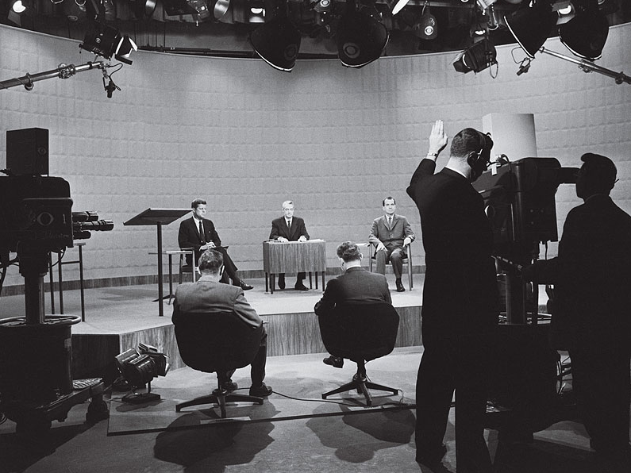
Network Era of U.S. Television
The Network Era refers to the period from the late-1950s through the mid-1980s during which the majority of households owned a television set but programming was dominated by three networks: ABC, CBS, and NBC.
01 – Six TV Families | Background

Slide 12
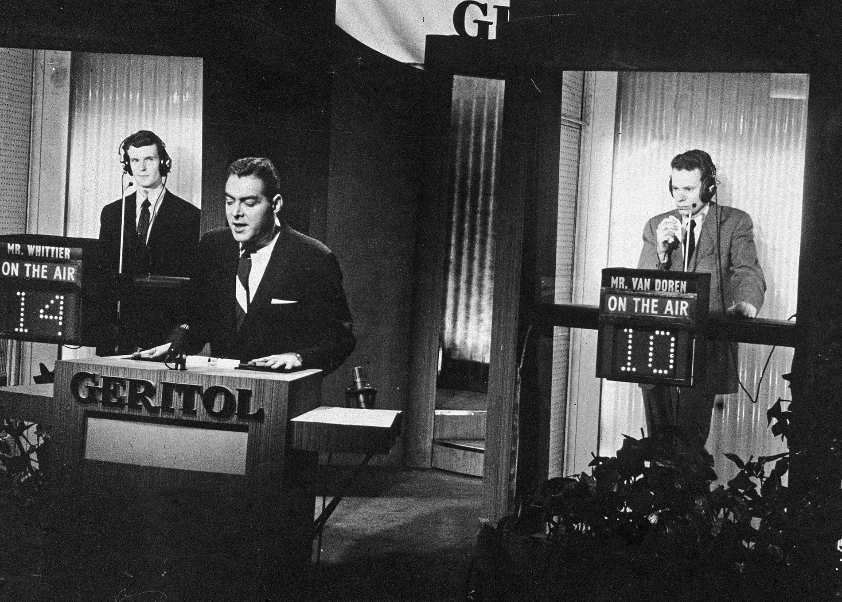
Network Era of U.S. Television
The Network Era refers to the period from the late-1950s through the mid-1980s during which the majority of households owned a television set but programming was dominated by three networks: ABC, CBS, and NBC.
Marked the end of the Golden Age of television and its more experimental shows. These were replaced by content designed to attract the largest number of viewers and be of interest across ages and demographics. These included game shows, family sitcoms, and police procedurals.
01 – Six TV Families | Background

Slide 13
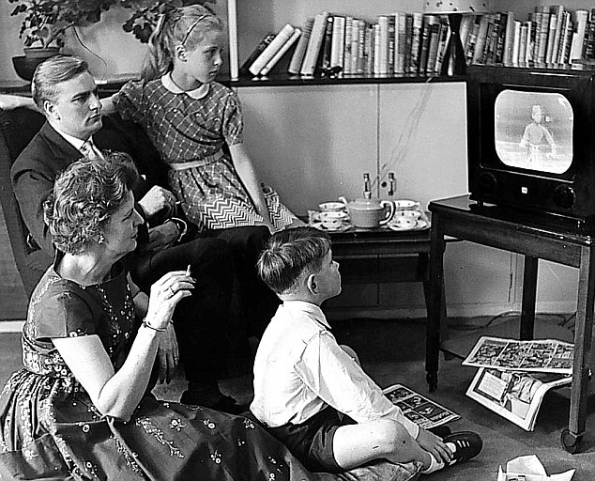
Network Era of U.S. Television
The Network Era refers to the period from the late-1950s through the mid-1980s during which the majority of households owned a television set but programming was dominated by three networks: ABC, CBS, and NBC.
Marked the end of the Golden Age of television and its more experimental shows. These were replaced by content designed to attract the largest number of viewers and be of interest across ages and demographics. These included game shows, family sitcoms, and police procedurals.
One theory of the Network-Era content, particularly in its earliest years, is what NBC’s Paul Klein called the least objectionable program. This mindset had a large impact on the programming decisions by executives from all three networks.
01 – Six TV Families | Background

Slide 14
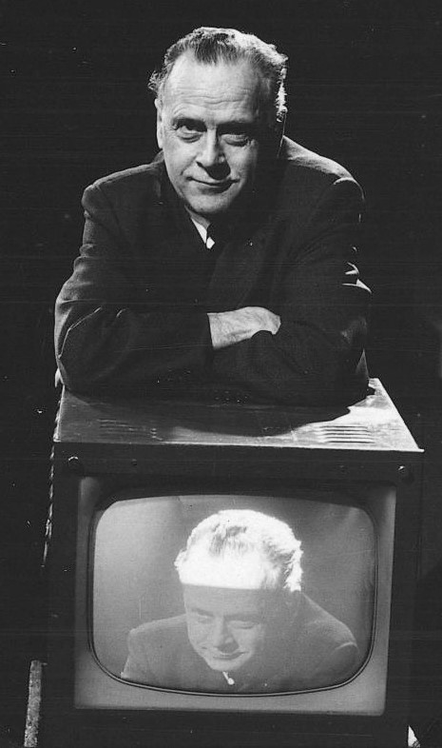
Network Era: Scholarship
There is a vast body of research concerning the influence of television on political, social, and cultural life in the United States throughout the Network Era (i.e., McLuhan, Spiegl, Lotz).
Marshall McLuhan (1967)
01 – Six TV Families | Background

Slide 15
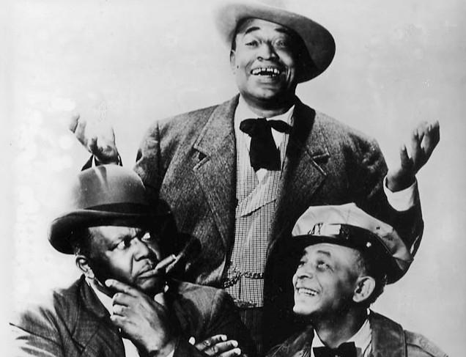
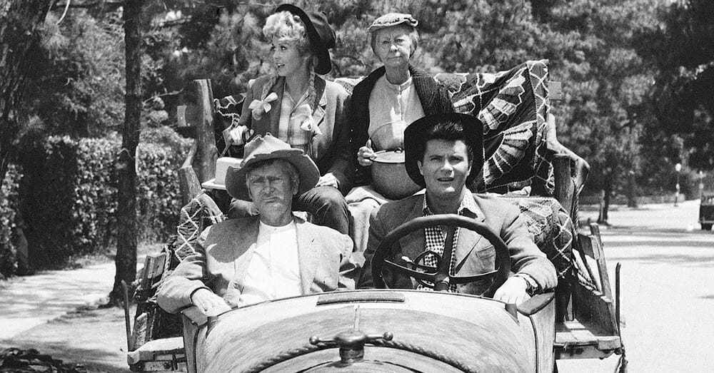
Network Era: Scholarship
There is a vast body of research concerning the influence of television on political, social, and cultural life in the United States throughout the Network Era (i.e., McLuhan, Spiegl, Lotz).
Can point to numerous series and episodes that made specific contributions to the national discourse surrounding issues such as second-wave feminism, the civil right’s movement, and growing urban-rural divide.
Cast of Amos 'n' Andy (1951-1953)
Cast of Beverley Hillbillies (1962-1971)
01 – Six TV Families | Background

Slide 16
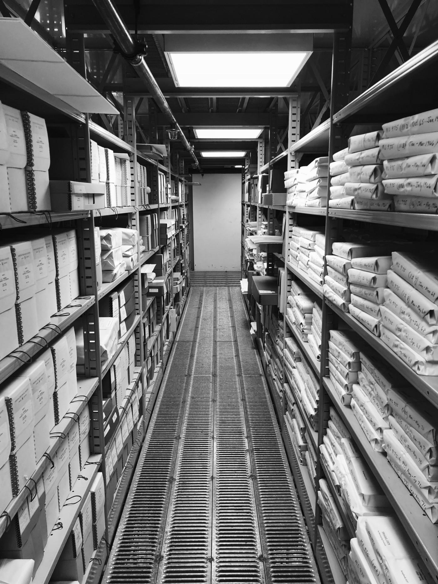
Network Era: Scholarship
There is a vast body of research concerning the influence of television on political, social, and cultural life in the United States throughout the Network Era (i.e., McLuhan, Spiegl, Lotz).
Can point to numerous series and episodes that made specific contributions to the national discourse surrounding issues such as second-wave feminism, the civil right’s movement, and growing urban-rural divide.
Prior scholarship has focused primarily on evidence drawn from archival studio records, plot summaries, historic reviews, and other textual documents.
Arizona Historical Society
01 – Six TV Families | Background

Slide 17
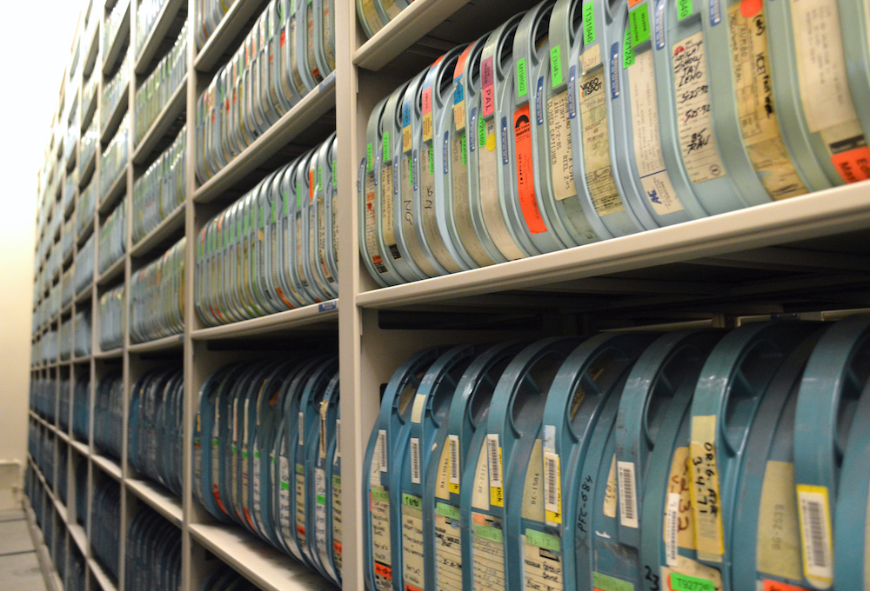
Network Era: Scholarship
There is a vast body of research concerning the influence of television on political, social, and cultural life in the United States throughout the Network Era (i.e., McLuhan, Spiegl, Lotz).
Can point to numerous series and episodes that made specific contributions to the national discourse surrounding issues such as second-wave feminism, the civil right’s movement, and growing urban-rural divide.
Prior scholarship has focused primarily on evidence drawn from archival studio records, plot summaries, historic reviews, and other textual documents.
The reputation of Network-Era materials as formless, middle-brow, LOPs, has discouraged significant study of its stylistic properties.
2-inch videoreels from UCLA Film & TV Archive
01 – Six TV Families | Background

Slide 18
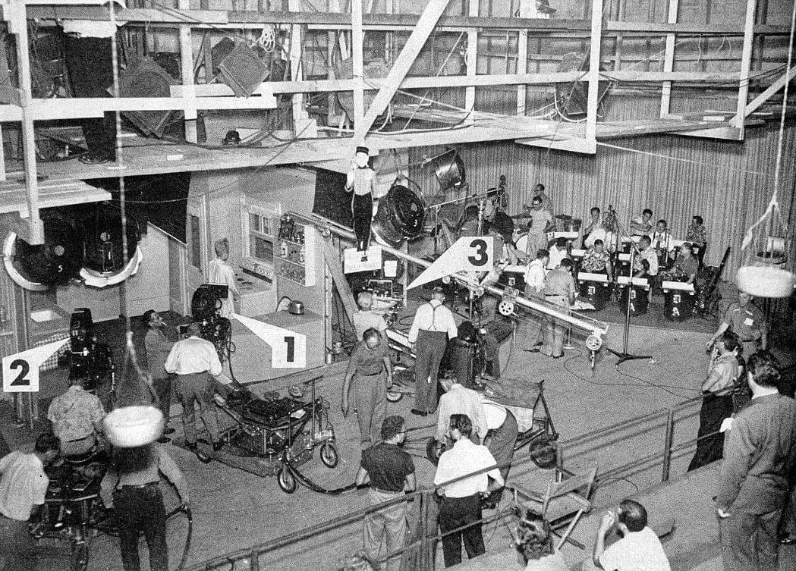
Network Era TV + Quantitative Analysis
Network Era sitcoms have small casts and a small repertoire of sets. They produced a large number of episodes, often more than 30 per season.
The consistent form and long runs have discouraged formal analysis. However, these are exactly the features that make them an excellent object of study for a quantitative analysis.
Can use the quantitative methods to find consistent but subtle patterns. The long runs and fixed features of the shows allow the patterns to appear in a way that is more challenging given the complex production elements of a single feature-length film.
Stage 2 of General Service Studio, where I Love Lucy TV was produced, showing the three-camera setup used on stage. American Cinematographer.
01 – Six TV Families | Background

Slide 19
3. Research Questions
01 – Six TV Families | Research Questions

Slide 20
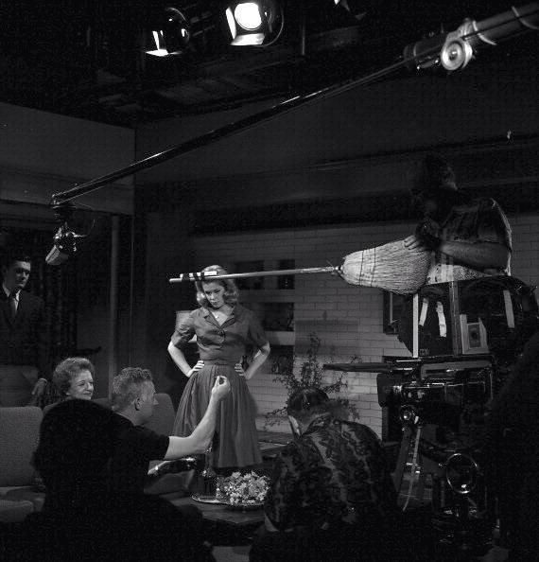
Research Questions
We focus on three research questions using a set of six Network Era sitcoms:
RQ #1: How does the framing of a shot contribute to the pacing of the episode and how do these elements differ across series, time, and other features?
Filming on the set of Bewitched (1965).
01 – Six TV Families | Research Questions

Slide 21
Research Questions
We focus on three research questions using a set of six Network Era sitcoms:
RQ #1: How does the framing of a shot contribute to the pacing of the episode and how do these elements differ across series, time, and other features?
RQ #2: What and how do the visual and aural form of the television shows establish the centrality and role of each character?
Filming on the set of Bewitched (1965).
01 – Six TV Families | Research Questions

Slide 22
Research Questions
We focus on three research questions using a set of six Network Era sitcoms:
RQ #1: How does the framing of a shot contribute to the pacing of the episode and how do these elements differ across series, time, and other features?
RQ #2: What and how do the visual and aural form of the television shows establish the centrality and role of each character?
RQ #3: What and how do the visual and aural form of the television shows establish relationships and intimacy between pairs of characters?
Now, let’s turn to some data and methods to let us address these questions.
Filming on the set of Bewitched (1965).
01 – Six TV Families | Research Questions

Slide 23
4. Data
01 – Visual Style | Data

Slide 24
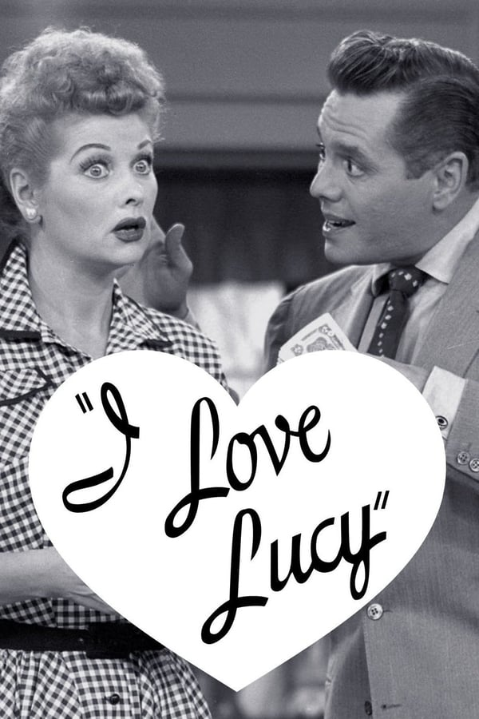
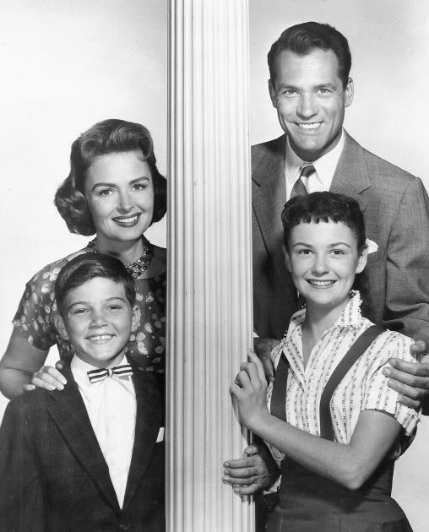
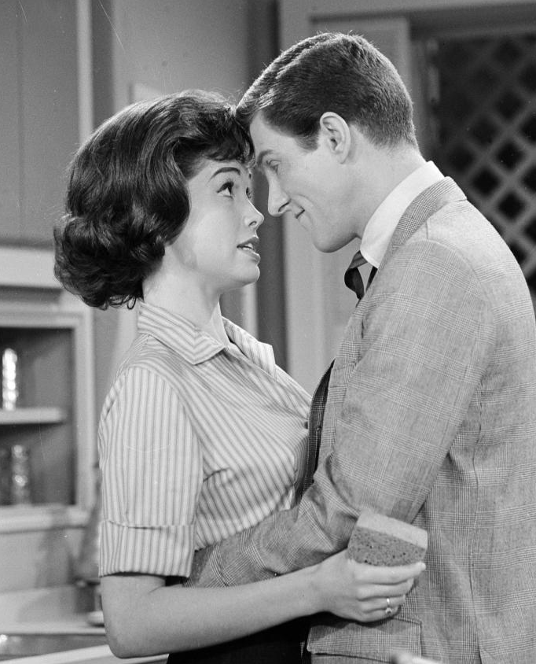
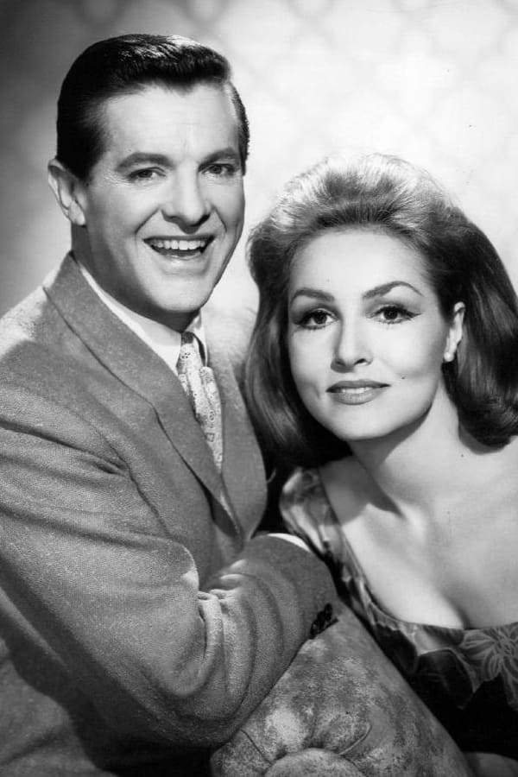
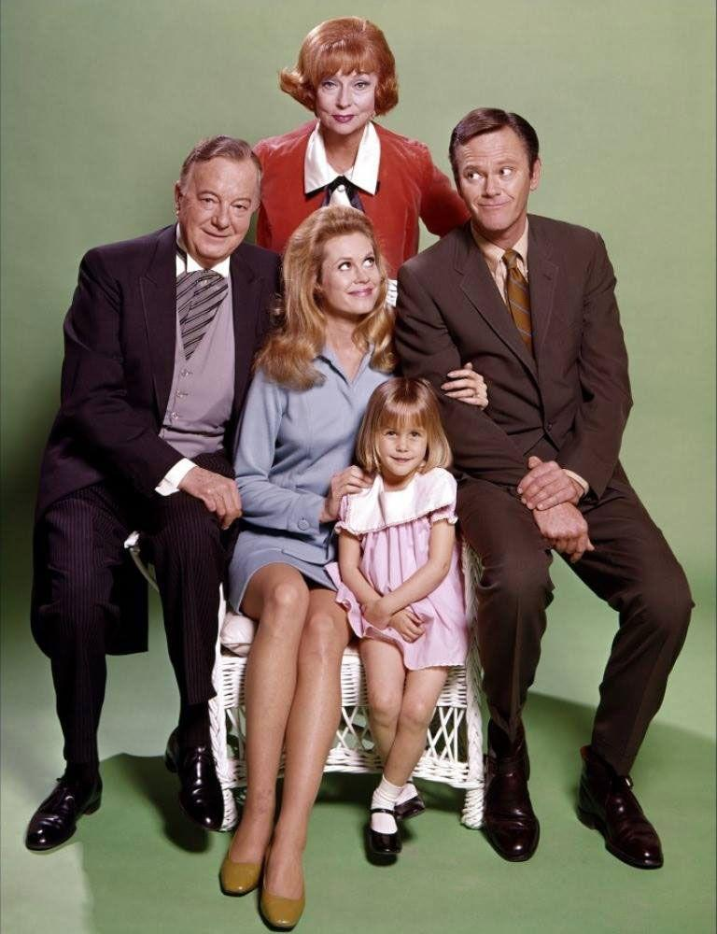
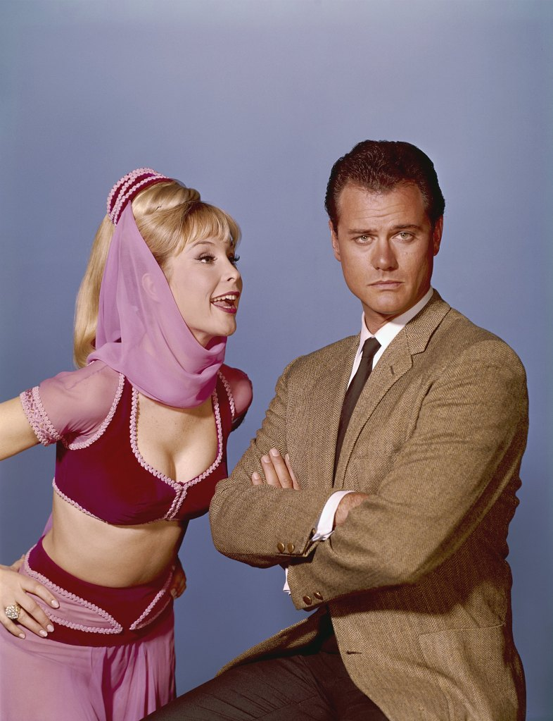
Six Sitcoms
Collection under study today consists of six family sitcoms from the 1950s and 1960s, all of which feature female leads.
The first set are three of the most popular family shows from the earliest decade of the Network Era. Lucy is often connected in scholarship to both Donna Reed and Dick Van Dyke (variety shows inside of a sitcom).
Next, three competing concepts from each of the three networks from the mid-1960s. Each feature an atypical leading female (robot, witch, and genie), trying to fit into a suburban domestic space.
I Love Lucy (CBS; 1951–1957)
The Donna Reed Show (ABC; 1958–1966)
Dick Van Dyke Show (CBS; 1961–1966)
My Living Doll (CBS; 1964–1965)
Bewitched (ABC; 1964–1972)
I Dream of Jeannie (NBC; 1965–1970)
01 – Six TV Families | Data

Slide 25
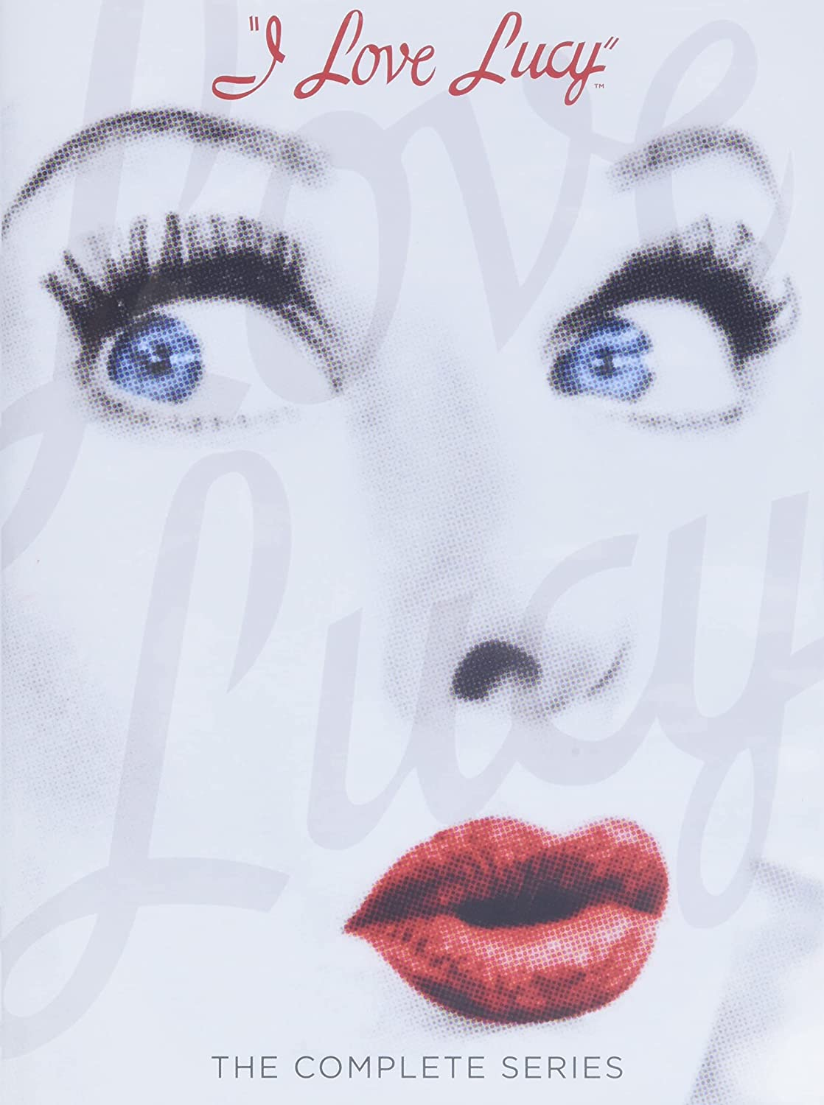

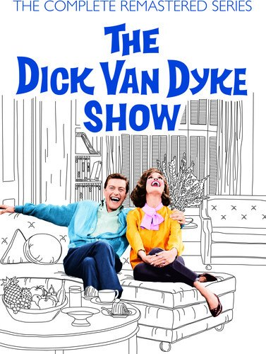
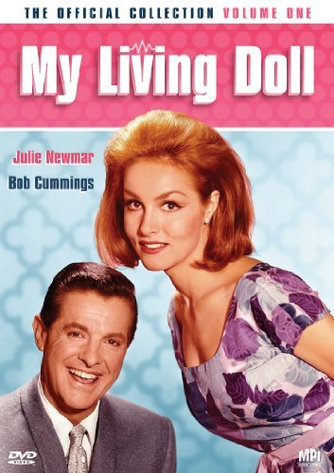
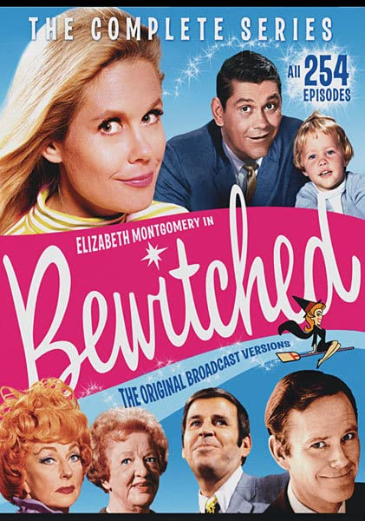
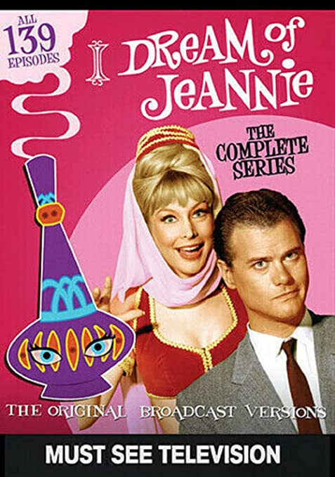
Data
Extracted files from every available epsiode of each series using commerically produced DVDs.
– 918 episodes across 30 seasons
– 28 TB of material (uncompressed)
– video, audio, chapter breaks, and subtitles
We have complete sets for 4 of the shows (Lucy, Dick Van Dyke, Bewitched, and, Jeannie). Only the first 5 seasons of Donna Reed have been released and all but 10 episodes of My Living Doll have been lost.
The first two seasons of Bewitched and first season of Jeannie were shot in B&W. Using the colorized version released that is most commonly syndicated and released on DVD.
Allowed exception to DMCA § 1201. Thanks to work with Samuelson Law Clinic at UC Berkeley.
01 – Six TV Families | Data

Slide 26
5. Methods
01 – Six TV Families| Methods

Slide 27
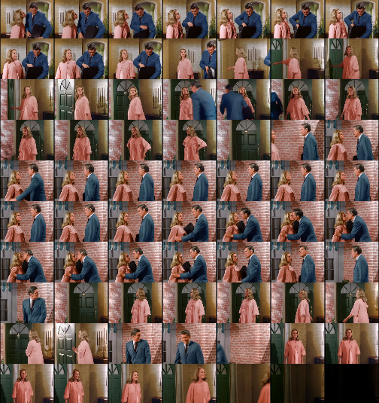
Methods
Raw pixel intensities are hard to interpret. We create automatically produced annotations by applying off-the-shelf computer vision algorithms to the individual frames.
– shot boundary detection
Li, Yanghao, et al. (2021) "Benchmarking Detection Transfer Learning with Vision Transformers." arXiv e-prints: arXiv-2111.
01 – Six TV Families | Methods

Slide 28
Methods
Raw pixel intensities are hard to interpret. We create automatically produced annotations by applying off-the-shelf computer vision algorithms to the individual frames.
– shot boundary detection
SHOT #1
SHOT #2
SHOT #3
SHOT #4
Li, Yanghao, et al. (2021) "Benchmarking Detection Transfer Learning with Vision Transformers." arXiv e-prints: arXiv-2111.
SHOT #5
SHOT #6
01 – Six TV Families | Methods

Slide 29
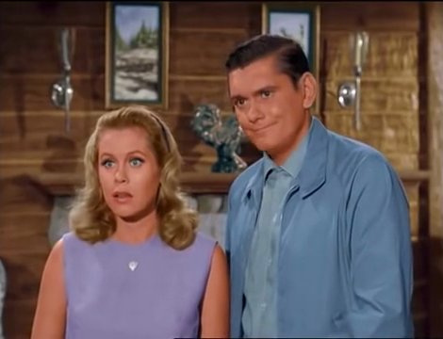
Methods
Raw pixel intensities are hard to interpret. We create automatically produced annotations by applying off-the-shelf computer vision algorithms to the individual frames.
– shot boundary detection
– face detection
Zhang, K., et al. (2016). "Joint face detection and alignment using multitask cascaded convolutional networks." IEEE Signal Processing Letters, 23(10):1499–1503.
01 – Six TV Families | Methods

Slide 30
Methods
Raw pixel intensities are hard to interpret. We create automatically produced annotations by applying off-the-shelf computer vision algorithms to the individual frames.
– shot boundary detection
– face detection
Zhang, K., et al. (2016). "Joint face detection and alignment using multitask cascaded convolutional networks." IEEE Signal Processing Letters, 23(10):1499–1503.
01 – Six TV Families | Methods

Slide 31
Methods
Raw pixel intensities are hard to interpret. We create automatically produced annotations by applying off-the-shelf computer vision algorithms to the individual frames.
– shot boundary detection
– face detection
– face recognition
Darrin (.63)
Samantha (.72)
Cao, Qiong, et al. (2018). "Vggface2: A dataset for recognising faces across pose and age." 13th IEEE international conference on automatic face & gesture recognition.
01 – Six TV Families | Methods

Slide 32
Methods
Raw pixel intensities are hard to interpret. We create automatically produced annotations by applying off-the-shelf computer vision algorithms to the individual frames.
– shot boundary detection
– face detection
– face recognition
– object + person detection
person (.992)
person (0.985)
Ren, Shaoqing, et al. (2015) "Faster R-CNN: Towards real-time object detection with region proposal networks." Advances in Neural Information Processing Systems 28(2).
01 – Six TV Families | Methods

Slide 33
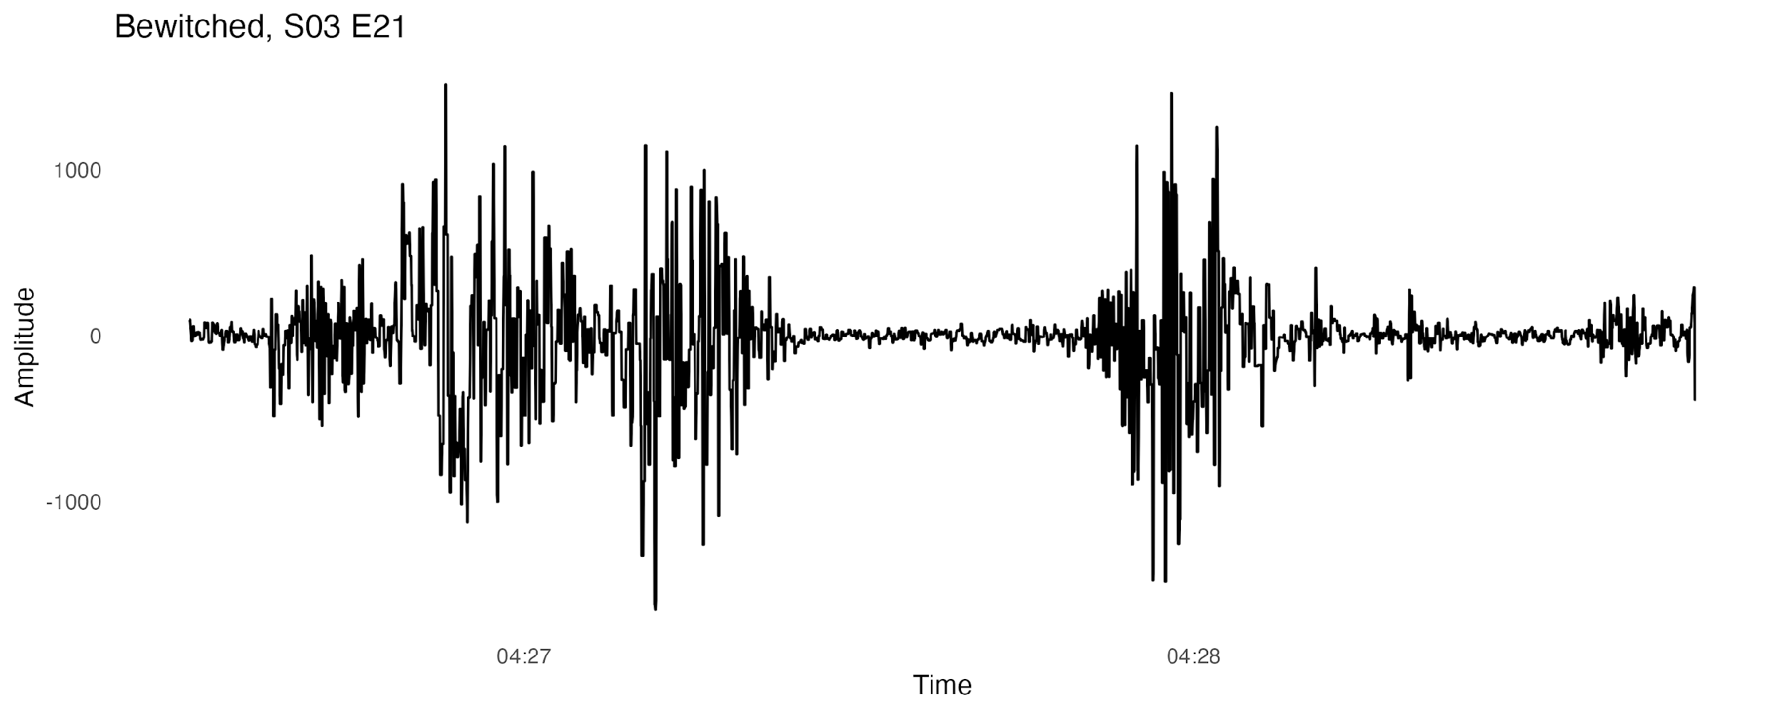
Methods
Raw pixel intensities are hard to interpret. We create automatically produced annotations by applying off-the-shelf computer vision algorithms to the individual frames.
– shot boundary detection
– face detection
– face recognition
– object + person detection
As well as algorithms for audio processing applied to the audio track:
– speaker detection
speech (.910)
speech (.943)
Bredin, Hervé and Antoine Laurent (2021). "End-to-end speaker segmentation for overlap-aware resegmentation." Proc. Interspeech 2021, 560.
01 – Six TV Families | Methods

Slide 34
Methods
Raw pixel intensities are hard to interpret. We create automatically produced annotations by applying off-the-shelf computer vision algorithms to the individual frames.
– shot boundary detection
– face detection
– face recognition
– object + person detection
As well as algorithms for audio processing applied to the audio track:
– speaker detection
– speaker segmentation
Speaker A
Speaker B
Bredin, Hervé and Antoine Laurent (2021). "End-to-end speaker segmentation for overlap-aware resegmentation." Proc. Interspeech 2021, 560.
01 – Six TV Families | Methods

Slide 35
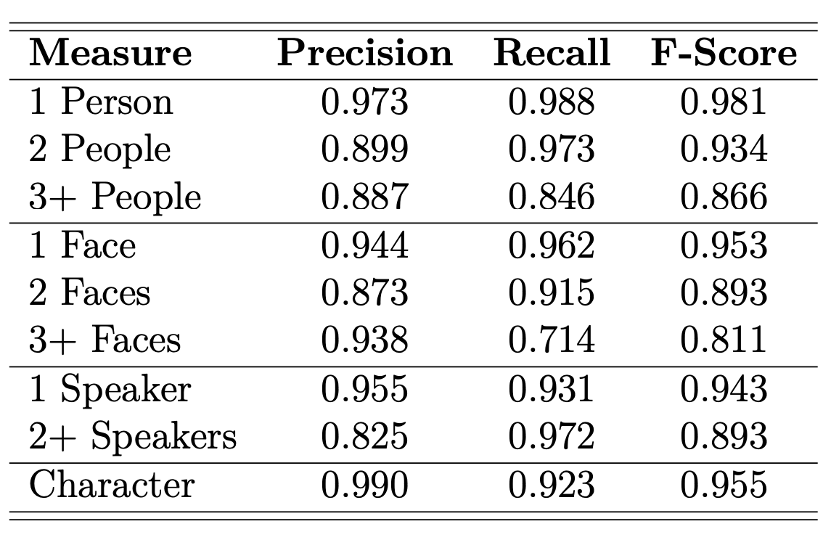
Methods
Raw pixel intensities are hard to interpret. We create automatically produced annotations by applying off-the-shelf computer vision algorithms to the individual frames.
– shot boundary detection
– face detection
– face recognition
– object + person detection
As well as algorithms for audio processing applied to the audio track:
– speaker detection
– speaker segmentation
The output of these algorithms were verified, aggregated, and processed to produce features that match the research questions.
Accuracy of binary tags applied to 100 randomly selected shots from each of the six series. Character tags are only computed when the face size was larger than 100 pixels. In the sample, the shot detection algorithm made 7 false cuts and missed only a single cut.
01 – Six TV Families | Methods

Slide 36
6. Results
01 – Six TV Families | Results

Slide 37
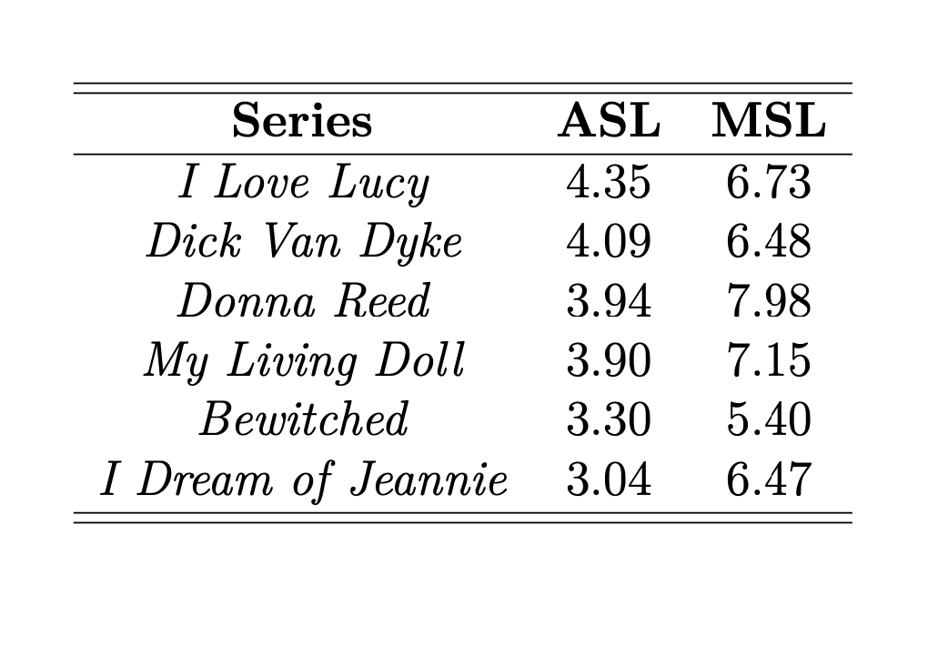
RQ #1: Shot Pacing (MSL + ASL)
Measurements of the average shot length (ASL) and the median shot length (MSL) are the two most commonly used metrics. In feature-length film, these both generally decreases over time.
We see a similar pattern, particularly with ASL.
01 – Six TV Families | Results

Slide 38
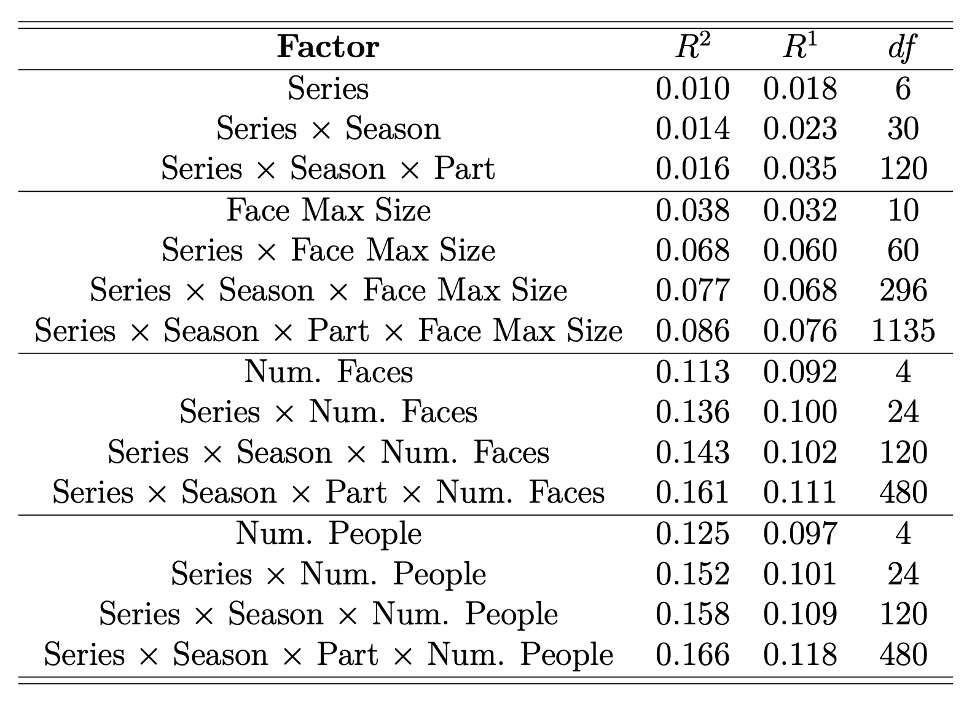
RQ #1: Shot Pacing (MSL + ASL)
But, what other variables might be associated with shot length? To investigate, fit a linear model (ASL) and a quantile regression model (MSL) to the individual shot lengths with various combinations of factors. Table shows the R2 and R1 scores.
Both measurements have some relationship to the maximum size of the faces (10 categories) in the shot, but are better explained by the number of faces (4 categories), and even more so the number of people (4 categories).
Note: In order to not be biased by the shot length, the number of faces and people is measured according to a single frame in the middle of the shot.
01 – Six TV Families | Results

Slide 39
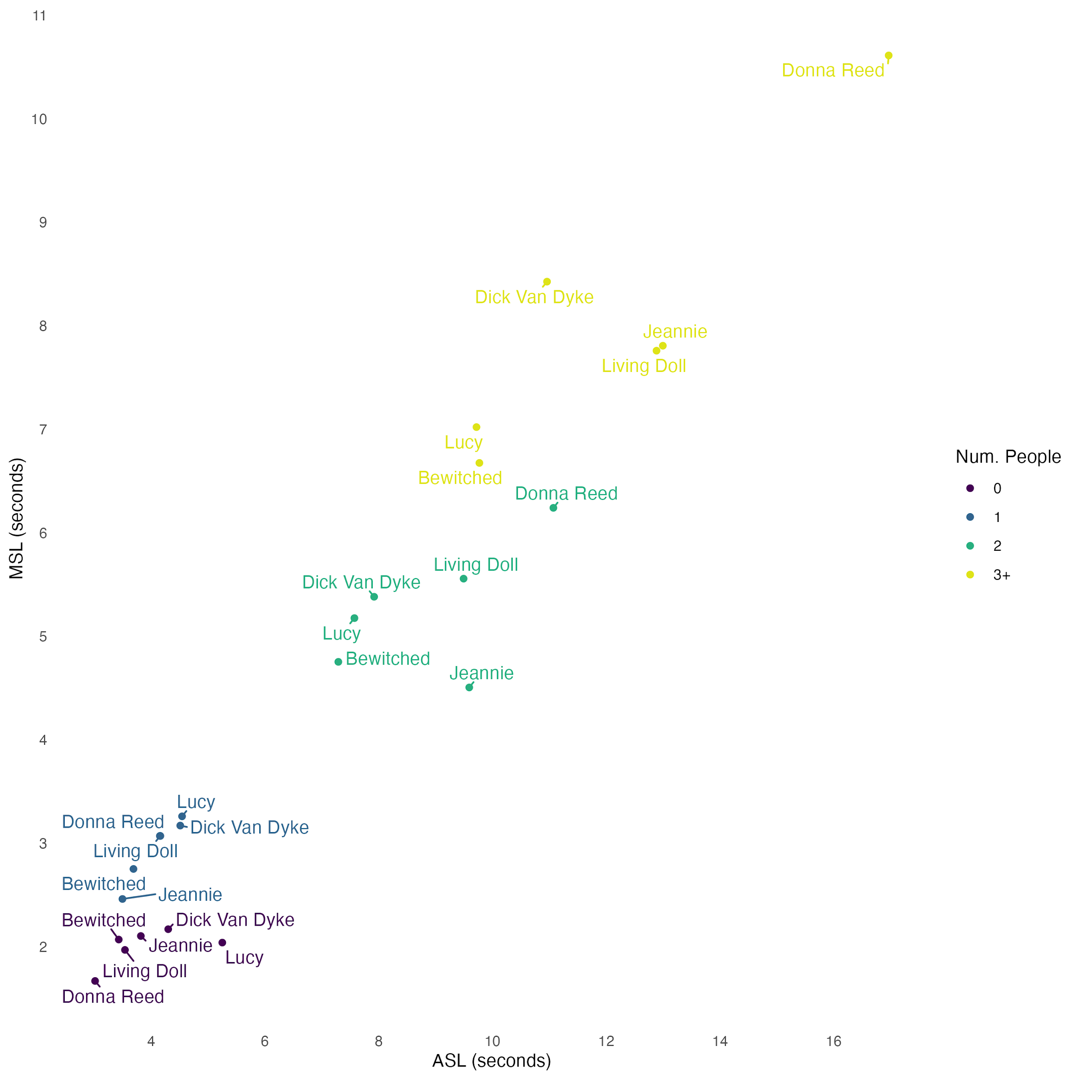
RQ #1: Shot Pacing (MSL + ASL)
Given this result, how do the MSL and ASL change if we look at them for each show by the number of people present?
The number of people contained in the shot has a strong, positive relationship with the MSL across these all six shows. ASL has less effect from 0-1 people but increases at 2 and 3+ people.
Shot type is not everything, though. After controlling for the number of people, there remain noticable differences across the shows. Donna Reed has noticably longer shots with 2+ people. Bewitched has some of the shortest shots with 1+ people. Other shows have patterns that show different effects along MSL/ASL.
01 – Six TV Families | Results

Slide 40
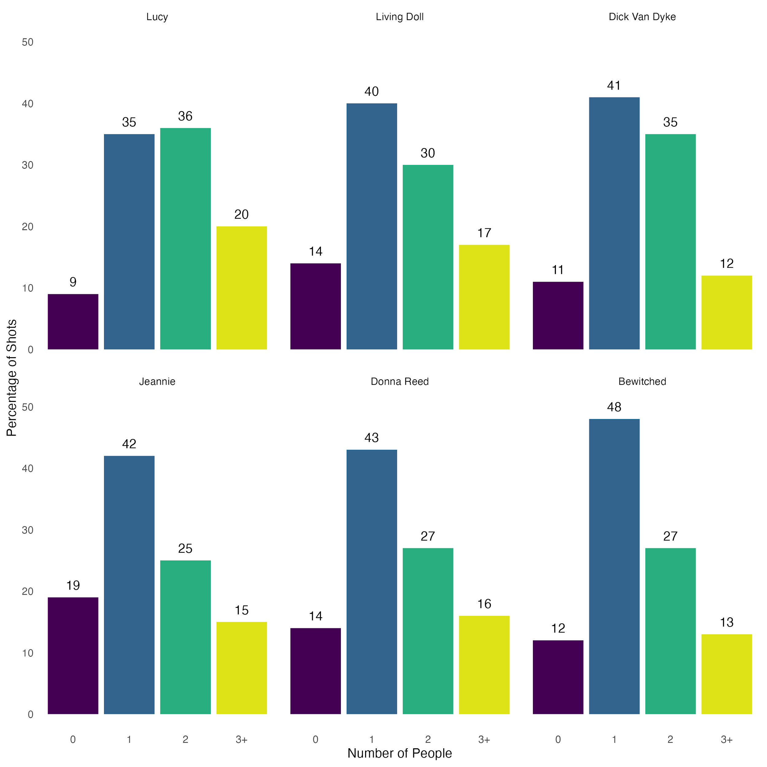
RQ #1: Shot Pacing (MSL + ASL)
Since the number of people has a strong effect on shot length, want to look at the distribution of shot types in each series.
Lucy uses the highest proportion of shots with 2 and 3+ people. These are the types with the longest duration across all shows. It has the largest ASL value.
Jeannie uses the largest proportion of shots with no people, the slowest shot type. It has the smallest ASL value.
The shows with the most extreme segmented types (Bewitched and Donna Reed) have the most extreme values for MSL.
01 – Six TV Families | Results

Slide 41
RQ #1: Shot Pacing (MSL + ASL)
For Network era TV, working hypothesis is that ASL serves as a good measurement for overall pace whereas MSL measures shot pace after accounting for shot type.
These relationships are complex, though. The data suggests that we need to continue to look at the underlying distributions of shot type and the duration of each shot type.
01 – Six TV Families | Results

Slide 42
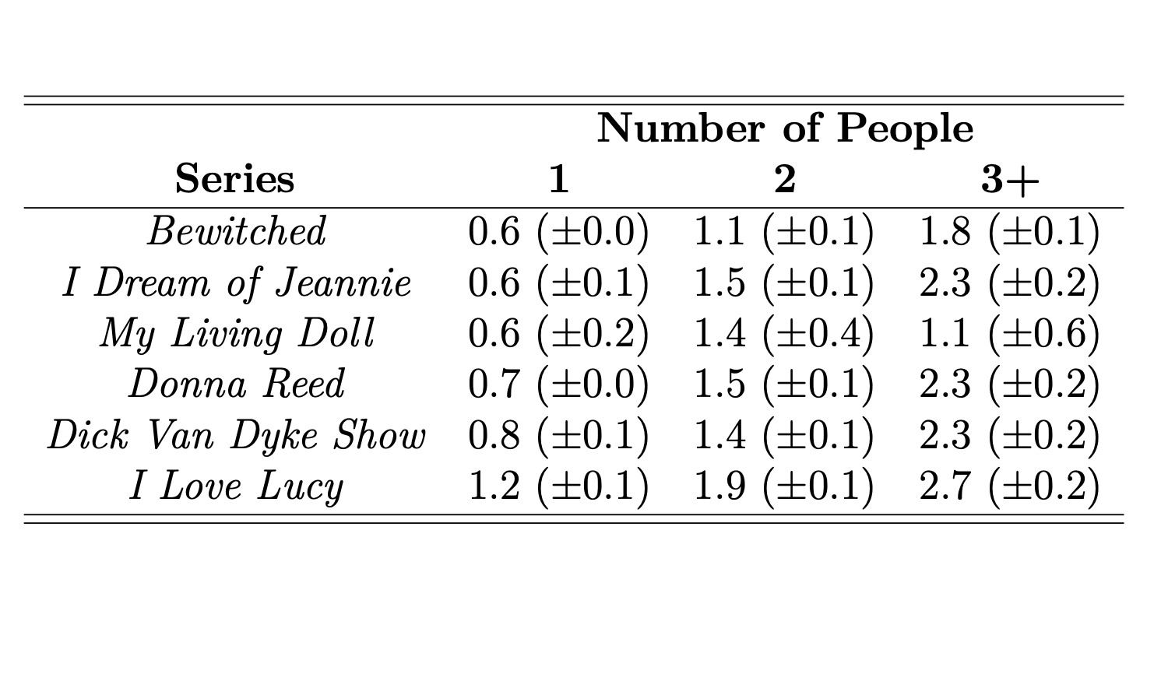
RQ #1: Shot Pacing (time to speech)
Look at the pacing of the aural side of the shows, calculate the median time after a shot that speech is first detected, also split by the number of people present.
Five shows have a median delay of 0.6-0.8 seconds when there is only one character present. Lucy, which relies more heavily on physical humor, takes about twice that amount of time.
Delay increases by around a factor of two when there are two people present, and slightly more with 3+ people.
01 – Six TV Families | Results

Slide 43
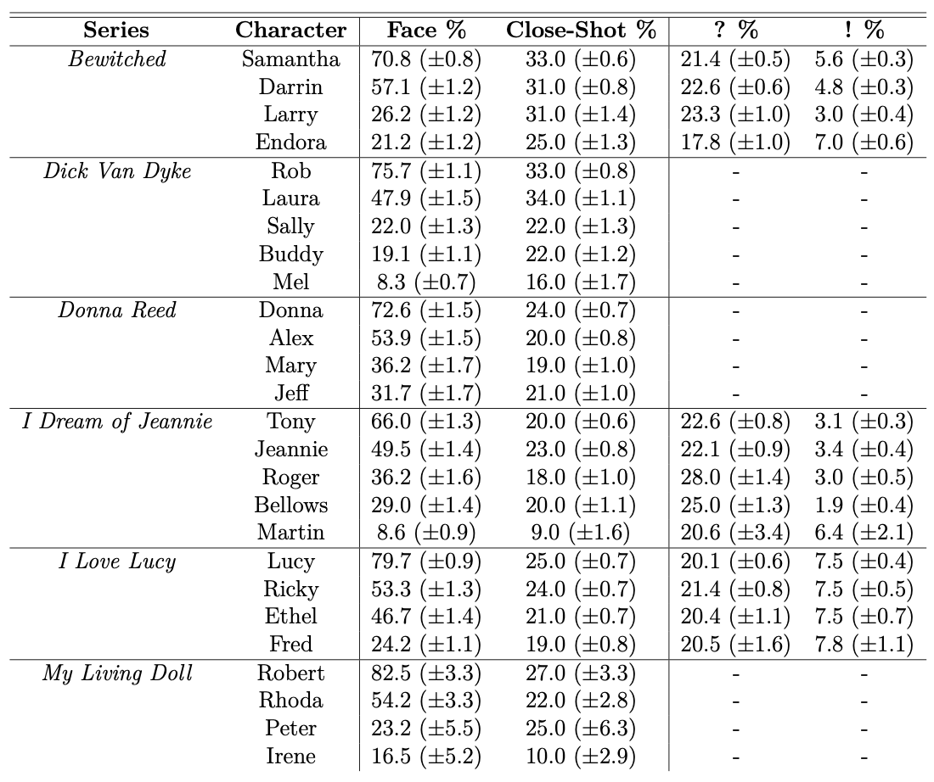
RQ #2: Individual Style
The main character(s) for each of these shows is not immediately clear from a summary of their concepts; in three of the shows, the issue of who was the central character became a major source of conflict.
Assign a character to be visually present if seen ±5 shots in both directions. Compute the percentage of time that there face is present or recently seen.
Every show has a clear dominant character who is present 66% or more of the time. Almost every show also has a clear second most dominant character, with Ricky and Ethel being not too far apart on Lucy.
01 – Six TV Families | Results

Slide 44
RQ #2: Individual Style
In addition to narrative centrality, when broadly present, how often is each character shown in a close shot?
These roughly follow the pattern of face percentages with a smaller effect size. Inversions are characters that dominate a specific space, but not the entire show. Laura Petrie and Jeannie dominate their respective domestic spaces. Larry dominates the workspace.
01 – Six TV Families | Results

Slide 45
RQ #2: Individual Style
Only three of the shows have subtitles. For those that do, we can see how often a close shot with a given character ends with a question mark or exclamation mark.
There’s little signal in Lucy, with questions occuring about 20% of the time and exclamations around 7.5% of the time.
Interesting patterns for Bewitched and I Dream of Jeannie. Magical figures are more likely to exclaim thing, particularly the trouble-maker Endora. The senior work characters Larry and Dr. Bellows both show their confusion and general lack of excitement through the punctuation marks.
01 – Six TV Families | Results

Slide 46
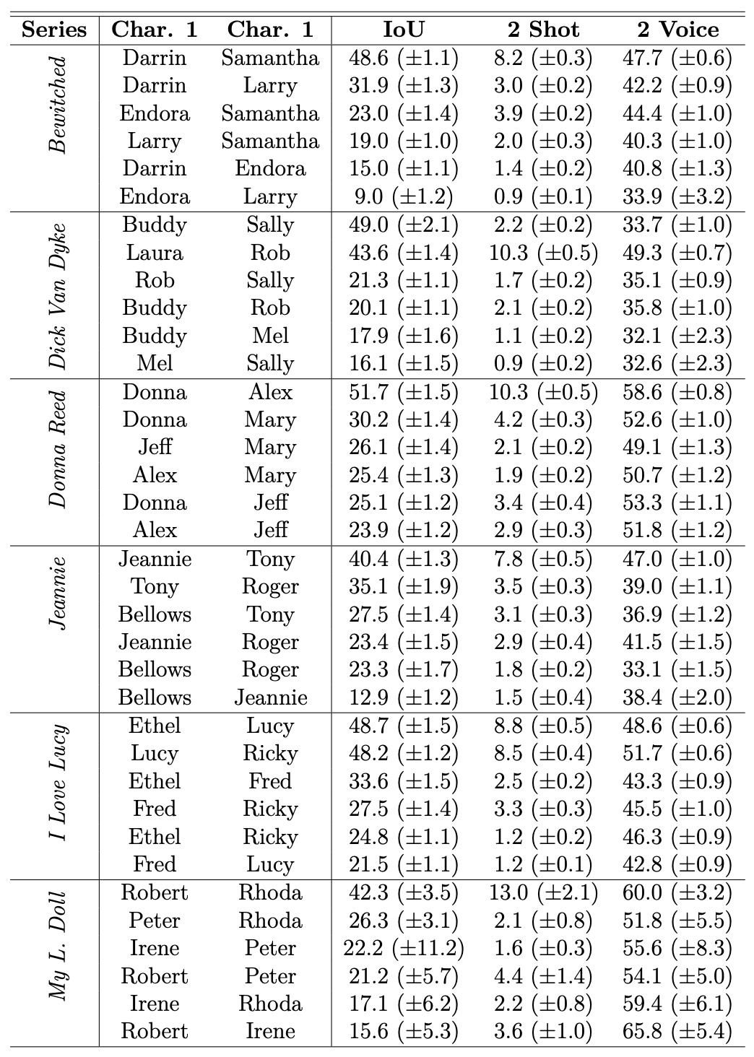
RQ #3: Character Pairs
One way to measure the relationship between two characters is to compute the average amount of time both are present divided by the amount of time either is (Intersection over Union; IoU).
These largely follow the pattern of linking the most dominant character with the second most dominant character (or two in the case of Lucy). This is not surprising but also not a given. Additionally, Dick Van Dyke has a pair of work-only characters that have a very high IoU score.
The second and third most common relationships correspond to characters that are linked by work, friendship, or family ties.
01 – Six TV Families | Results

Slide 47
RQ #3: Character Pairs
We can also compute the percentage of the entire series where each character is together in a two-shot while another character is also present in the scene.
Mostly follows the same pattern, but downplays the Buddy and Sally work-only relationship.
The effect size here is notable. Highest percentage for each show (plus the two for Lucy) are around 7.8% or more. The next highest is at most half of that, and often even less.
01 – Six TV Families | Results

Slide 48
RQ #3: Character Pairs
Finally, we can look, when the two characters are in a two-shot with another character also present in the scene, how often the two characters both speak.
Even though these are relative measurements, they almost all correspond to the ordering of the pairs by the IoU measurement, with the exception of the Buddy and Sally work-only relationship and one very small example from My Living Doll.
01 – Six TV Families | Results

Slide 49
7. Eye tracking
01 – Six TV Families | Eye tracking

Slide 50
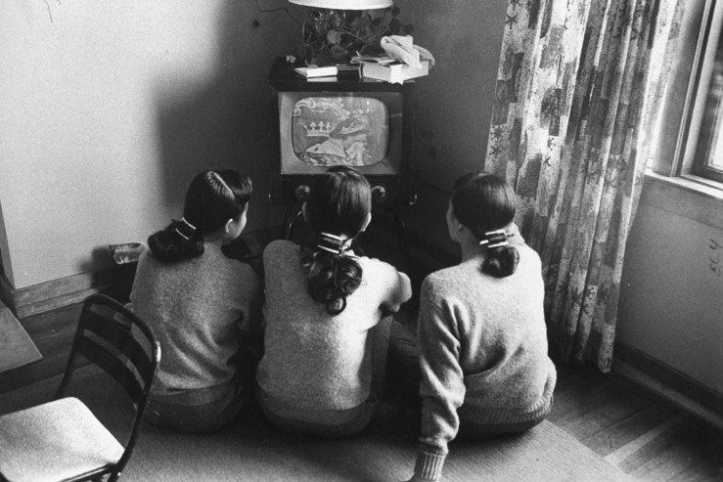
Reception
One question naturally arises with these results is how they relate the way the materials would be watched and received. As follow-up questions, would like to know:
RQ #4: Do people tend to focus on people and faces on screen? How long does it take to refocus after a cut?
RQ #5: When multiple faces are present, do people look at both? What effects whether they do.
Women watching television, Chicago (1960).
01 – Six TV Families | Eye tracking

Slide 51
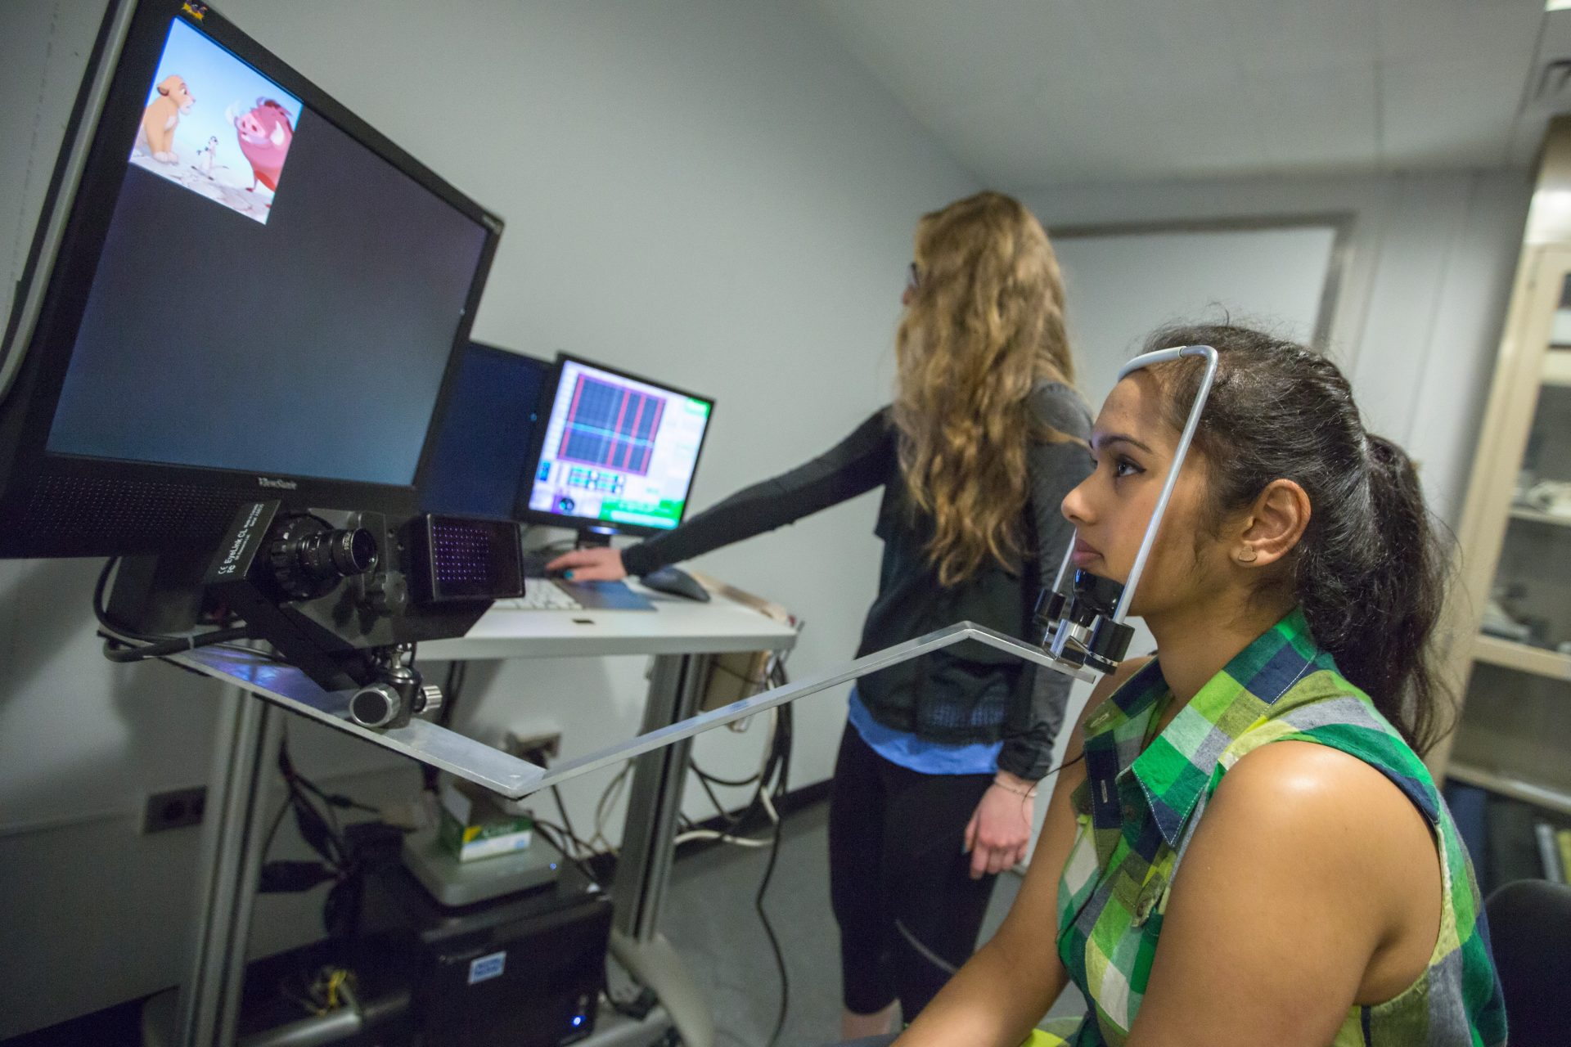
Reception
One question naturally arises with these results is how they relate the way the materials would be watched and received. As follow-up questions, would like to know:
RQ #4: Do people tend to focus on people and faces on screen? How long does it take to refocus after a cut?
RQ #5: When multiple faces are present, do people look at both? What effects whether they do.
Will not be able to fully answer these rich questions, but can get some answers using an existing, open eye tracking dataset (63 participants watching 125 clips).
Example experimental setup in an eye-tracking laboratory.
Costela, Francisco and Russell Woods (2019). "A free database of eye movements watching ‘Hollywood’ videoclips." Data in Brief, 5(2019): 1-9.
01 – Six TV Families | Eye tracking

Slide 52
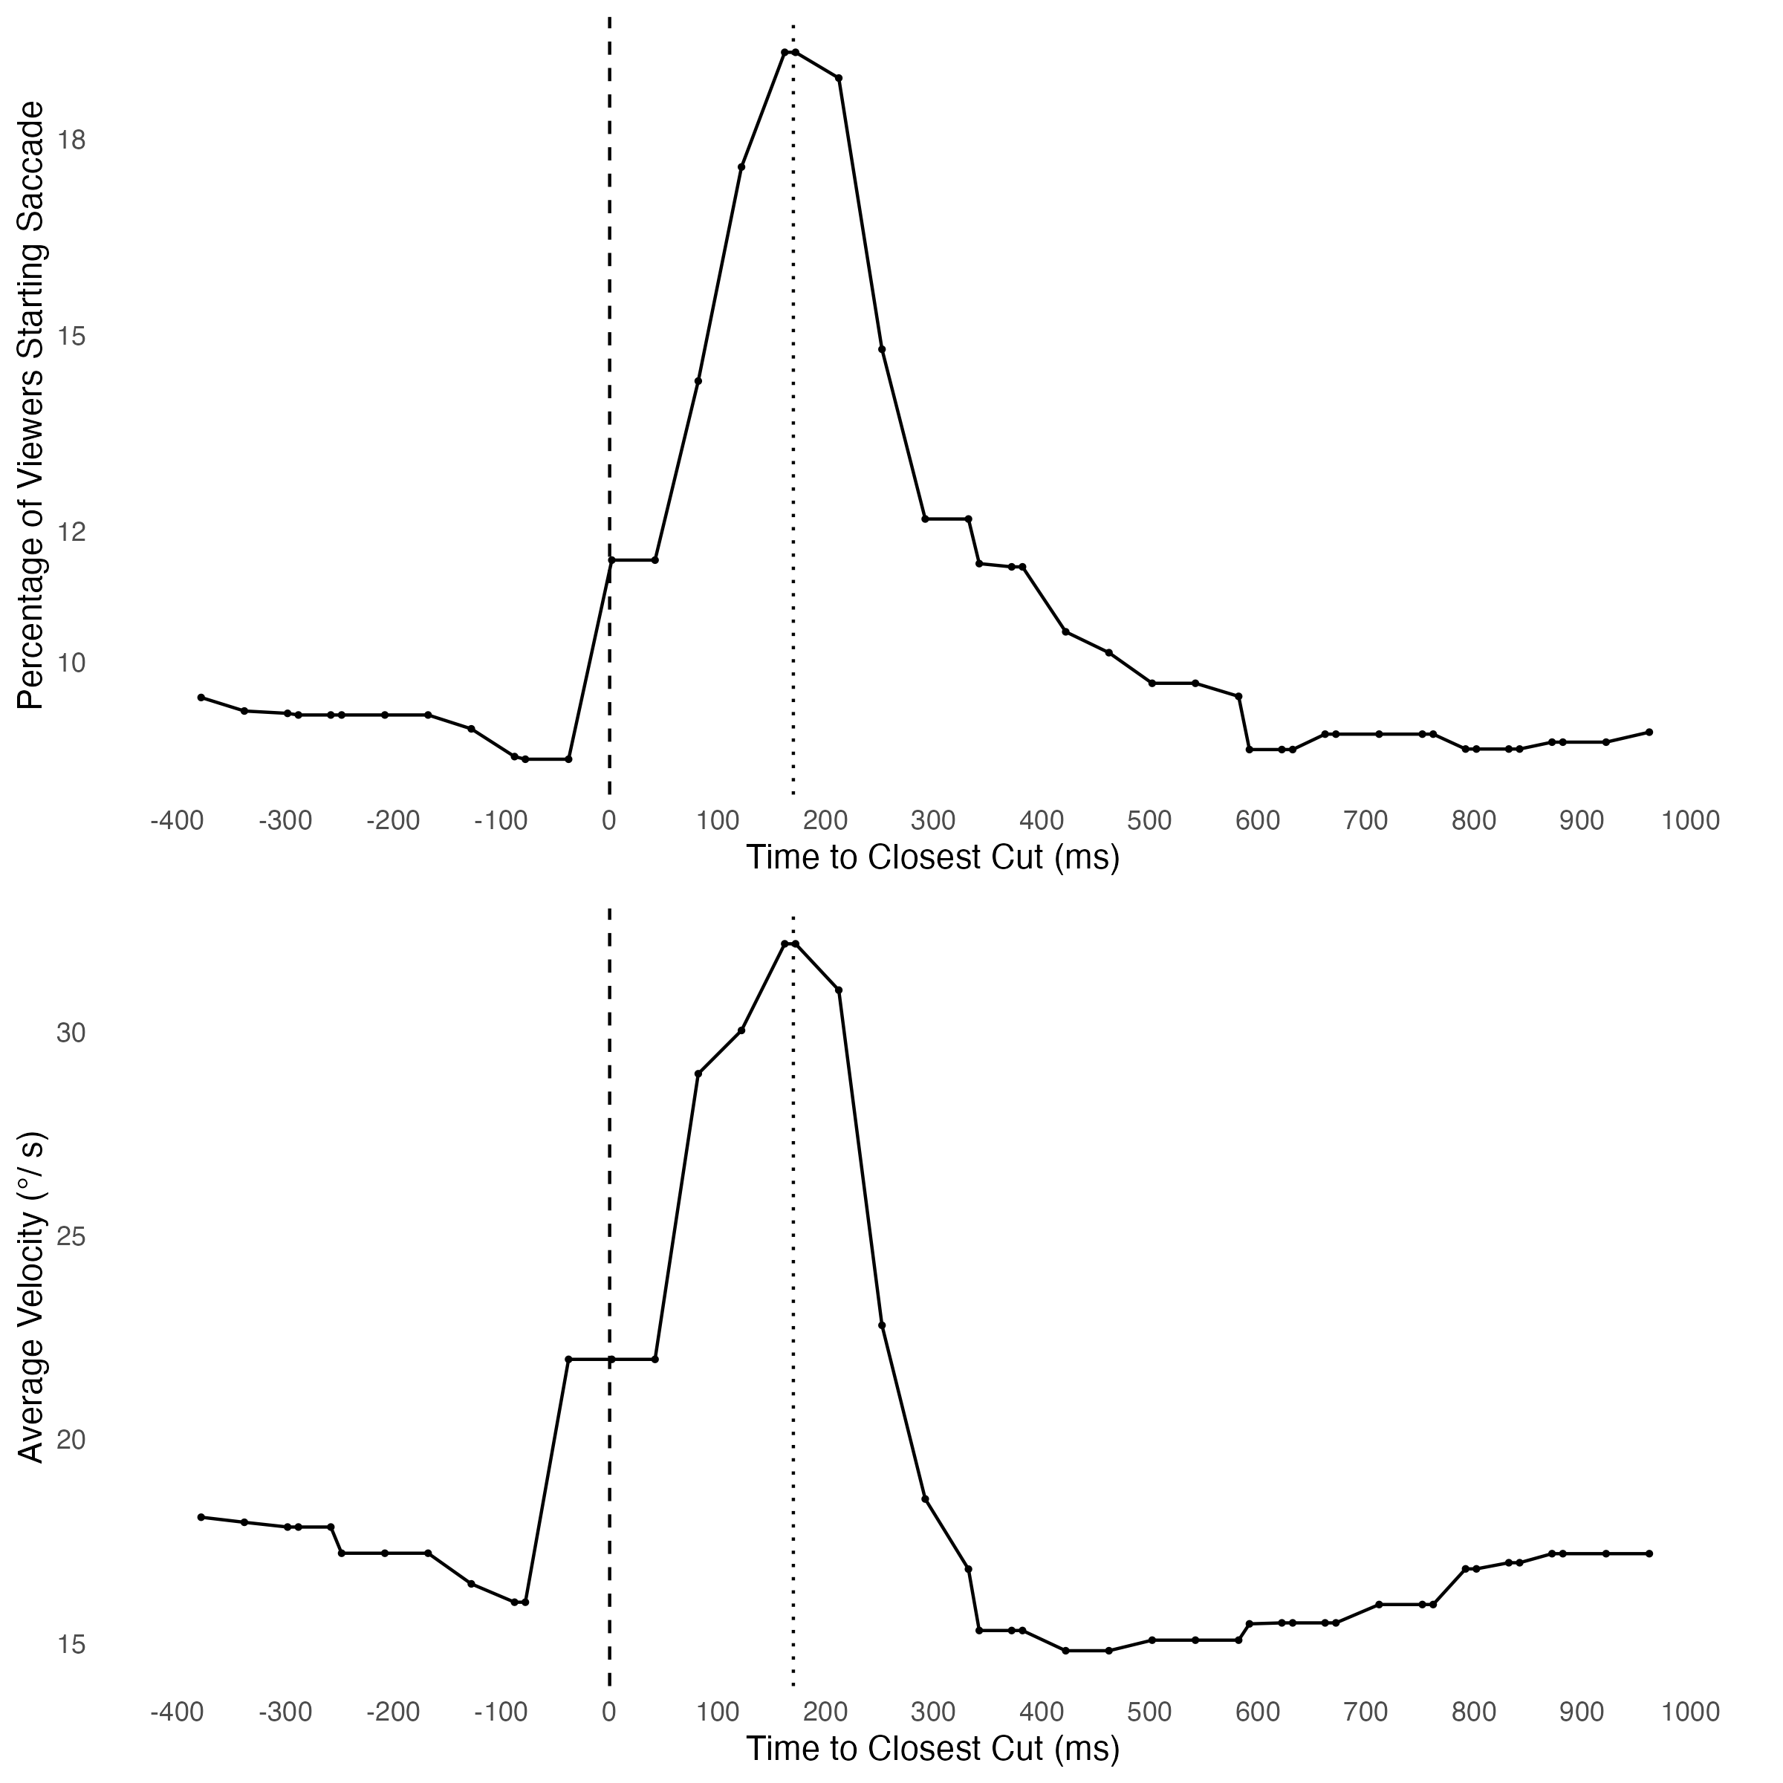
RQ #5: Reaction to shot breaks
Rapid eye movements known as saccades occur frequently across the dataset. These peak between 170-190 ms, the average of eye movements peaking around an average of over 30°/s of angular velocity.
01 – Six TV Families | Eye tracking

Slide 53
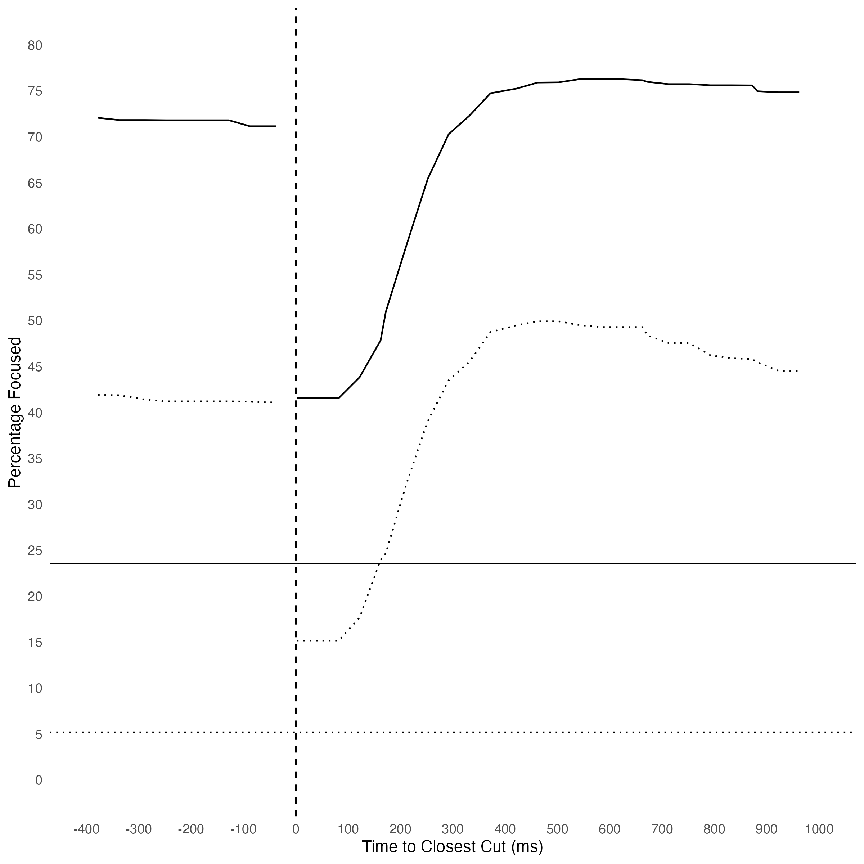
RQ #5: People and Faces
Rapid eye movements known as saccades occur frequently across the dataset. These peak between 170-190 ms, the average of eye movements peaking around an average of over 30°/s of angular velocity.
The participants are much more likely to focus on pixels corresponding to people (>3x) and faces (10x) than they would be random chance. Focus peaks around 500-600 ms after a shot break.
% Focused on Person
% Focused on Face
% Person (baseline)
% Face (baseline)
01 – Six TV Families | Eye tracking

Slide 54
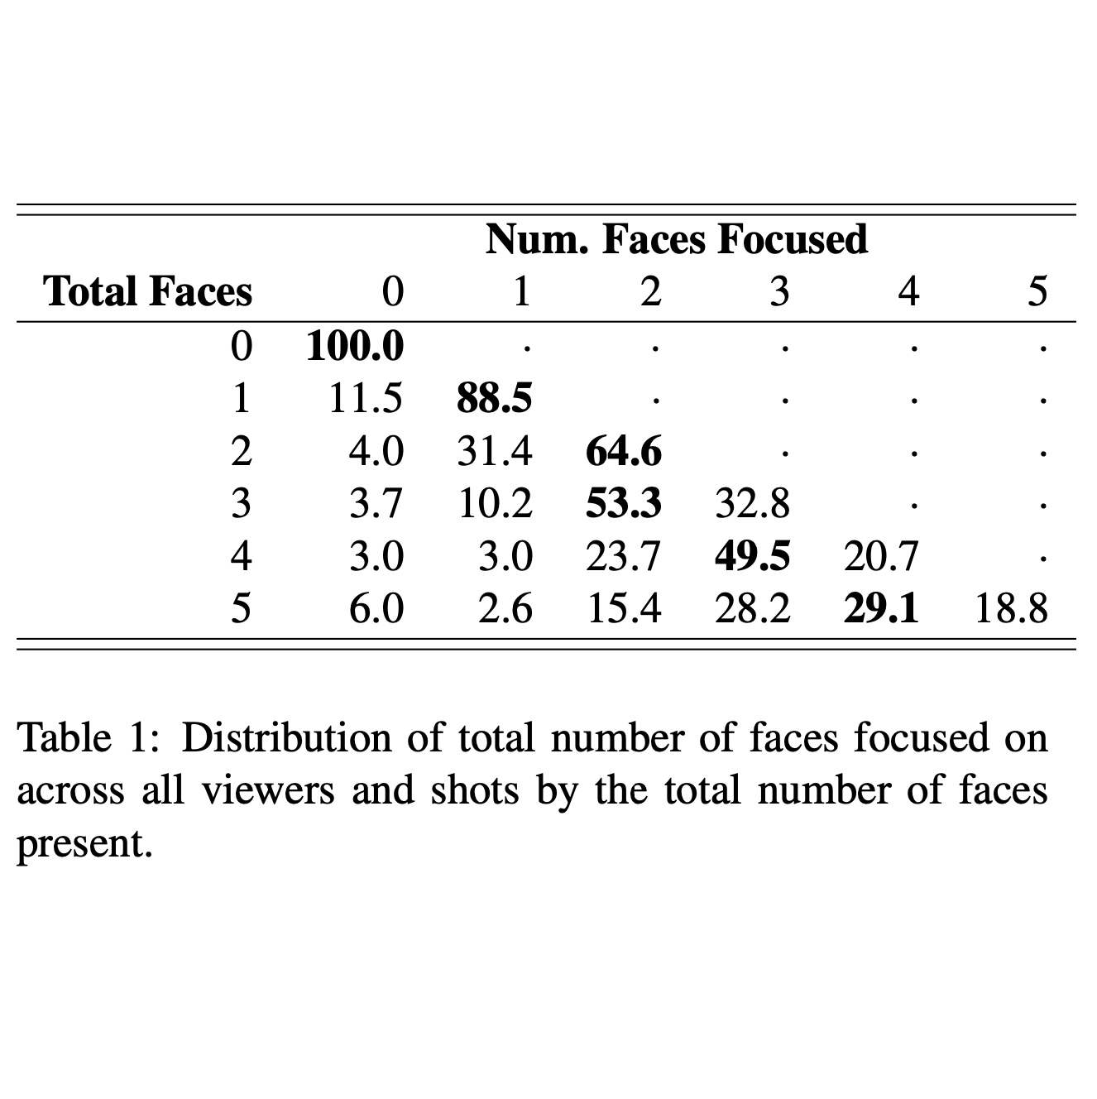
RQ #6: Number of faces focused
Rapid eye movements known as saccades occur frequently across the dataset. These peak between 170-190 ms, the average of eye movements peaking around an average of over 30°/s of angular velocity.
The participants are much more likely to focus on pixels corresponding to people (>3x) and faces (10x) than they would be random chance. Focus peaks around 500-600 ms after a shot break.
Viewer tend to focus on at least 2 different faces when present in a shot (65%+).
01 – Six TV Families | Eye tracking

Slide 55
8. Conclusions
01 – Six TV Families | Future Directions

Slide 56
Research Questions: Summary
To summarize the results of each research question:
RQ #1: The median and average shot length are correlated with the number of people present in the shot. The median time to start talking after a shot break increases with the number of people as well; gap corresponds to the time to focus (~ 600ms).
RQ #2: Overall visual presence highlights character centrality. The proportion of close shots indicates characters who are only visually present in a particular space of the show. Subtitles can show the role of each character in the narrative space.
RQ #3: Time together on screen helps highlight strength of relationships between characters. Talking together in a two-shot correlates with the same pattern.
RQ #4: Eye-tracking data offers evidence that people tend to focus on people’s faces and bodies. Gap to refocus aligns with the median gap in character dialog (#1).
RQ #5: Eye-tracking data offers evidence that people tend to focus on multiple faces in a shot with more than one person.
01 – Six TV Families | Conclusions

Slide 57
Thank You !

